Slide 1
The Intersection of Special Education and New PreK-12 Digital Accessibility Requirements
Webinar: December 10, 2024
Coaching Session: December 12, 2024

Slide 2


Today's Presenters
Project Director: Cynthia Curry, MSEd
TA Specialist: Jena Fahlbush, MEd

Slide 3
Webinar Resources
Links and slides available at bit.ly/idea-ada.
Recording will be available tomorrow morning.
Review Webinar Part 1, Act Now: Understanding New PreK-12 Digital Accessibility Requirements at bit.ly/ada-k12.

Slide 4
Webinar Evaluation
A survey will be sent to all attendees later this week, after the coaching session.
Confidential and fewer than five minutes of your time.

Slide 5



Webinar Communication
Please use the Zoom Q&A for any questions for the presenters.
During the Q&A at the end, Raise Hand in Zoom to unmute and use your microphone to ask questions.
Use Zoom Chat to talk to each other, reply, and share.

Slide 6
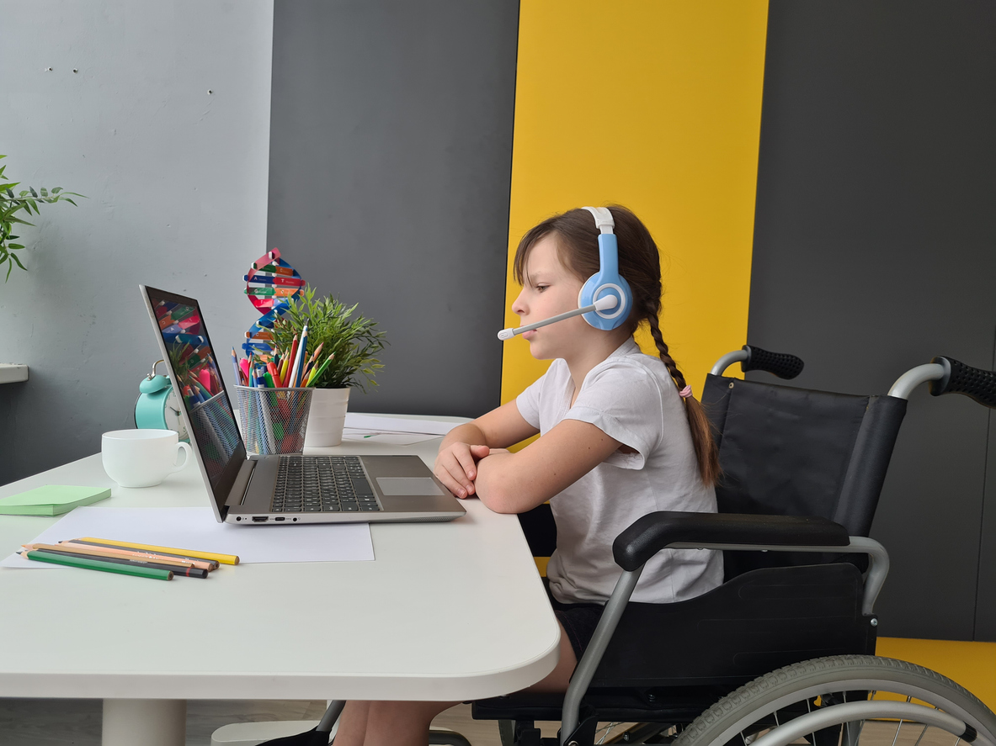
About NCADEMI
A new technical assistance center funded by the U.S. Department of Education's Office of Special Education Programs (OSEP) to improve the quality, availability, and timely provision of accessible digital educational materials and instruction for learners with disabilities from preschool through high school graduation.

Slide 7




The Home of NCADEMI
A project at Utah State University​
Administered within Utah’s University Center for Excellence in Developmental Disabilities - the Institute for Disability Research, Policy & Practice (IDRPP)
A partnership between Web Accessibility in Mind (WebAIM) and Technical Assistance for Excellence in Special Education (TAESE)​ within the IDRPP

Slide 8
Objectives
Understand the difference between the following two laws with respect to the provision of accessible materials for students with disabilities:
  Title II of the Americans with Disabilities Act (ADA)
  Individuals with Disabilities Education Act (IDEA)
Identify immediate steps to meet the requirements of both laws.

Slide 9
True & False Before
Students with disabilities can only receive accessible digital materials through the IEP process.

Slide 10
Frequently Used Interchangeably
“Accessible”
“Available”
“Inclusive”
“Affordable”
“Usable”

Slide 11

“Accessible” in Federal Law & Guidance
An individual with a disability can ​
access the same information,​
engage in the same interactions,​ and ​
otherwise participate in or benefit from the same services, programs, and activities ​
as individuals without disabilities, in a manner that provides substantially equivalent timeliness, privacy, independence, and ease of use.​
Department of Justice, Civil Rights Division & Department of Education, Office for Civil Rights
Notes:
Decorative image by Schwarzenarzisse used under the Pixabay Content License: https://pixabay.com/photos/isolated-auction-dish-paragraphs-2532037/

Slide 12
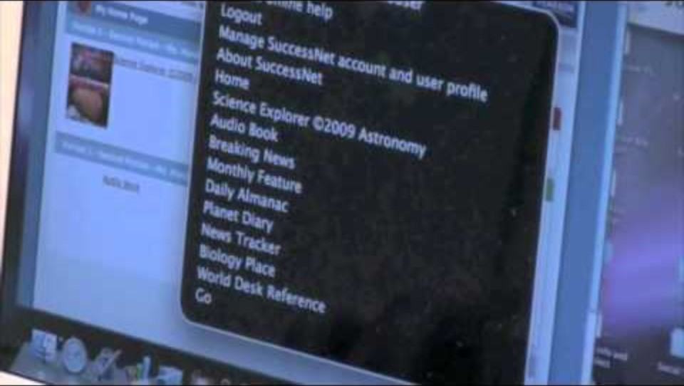
Digital Accessibility in Action (2008)
Notes:
Video available on the YouTube channel of Maine CITE: https://www.youtube.com/watch?v=UIZAvQWGyDE

Slide 13
Accessible Educational Materials (AEM)
“Print- and technology-based educational materials, including printed and electronic textbooks and related core materials that are required by SEAs and LEAs for use by all students, produced or rendered in accessible media, written and published primarily for use in early learning programs, elementary, or secondary schools to support teaching and learning.”​
U.S. Department of Education, 2014 (footnote 10)
Notes:
U.S. Department of Education. (2014, May 9). Notice of Intent to Establish a National Center on Accessible Educational Mater [Notice]. Federal Register, 79(90), 26677-26679.​

Slide 14
Two Pathways to Provide Accessible Materials
A student needs accessible materials
Provide digital materials produced to be accessible from the beginning
Provide materials rendered in accessible formats (e.g., braille, audio, large print)

Slide 15
Legal Obligations
Digitally Accessible from the Beginning for Everyone
ADA Title II
Retrofitted for Accessibility for Eligible Students
IDEA
Both laws require accommodations to be made for students with disabilities.

Slide 16
ADA Title II - Accessible from the Beginning
ADA provides broad protection against discrimination
Title II of the ADA applies to state and local government, including state and local educational agencies (SEAs & LEAs)
New rule mandates proactive digital accessibility, including in education
Includes:
      Technical standards
      Compliance deadlines
      Exceptions

Slide 17




Examples of Digital Materials Required to Conform
Websites & Digital Textbooks
Online Learning Platforms, Apps, & Tools
Videos & Slide Presentations
Teacher-created & -curated materials

Slide 18
IDEA - Retrofitting to Accommodate
IDEA makes available a free appropriate public education to eligible students with disabilities
Requires SEAs and LEAs to provide accessible formats when needed by a student with a disability
Established the National Instructional Materials Accessibility Standard (NIMAS) and the National Instructional Materials Access Center (NIMAC)
Requires SEAs to adopt NIMAS and require it of publishers

Slide 19
Materials Covered under IDEA
IDEA 2004: “Printed textbooks and related printed core materials that are written and published primarily for use in elementary school and secondary school instruction and are required by a State educational agency or local educational agency for use by students in the classroom.”
2020: A Notice of Interpretation clarified that the definition of “print instructional materials” includes digital instructional materials when those can be converted into the valid NIMAS format.

Slide 20
Examples of Accessible Formats
Print or Digital Text
Audio
Braille
Accessible digital text
Large print
Audio
Tactile graphics of images
Text transcript
Video
Captioned video
Audio described video
Video with synchronized American Sign Language (ASL)

Slide 21
Accessible Formats and the IEP
More to the Myths and Facts: Addressing Accessible Educational Materials in the 2024 Assistive Technology Guidance
Determination of a student's need
Selection of the appropriate format
Identification of the source of the format
Support for the use of accessible formats

Slide 22
True & False After
Students with disabilities can only receive accessible digital materials through the IEP process.

Slide 23
Calls to Action!
Investigate whether your state/district IEP form or guidance includes considerations for accessible materials.
Confirm that your state or district contract or purchase order language directs publishers to submit NIMAS files to the NIMAC.
Host a shared reading of More to the Myths and Facts with colleagues.

Slide 24
Remember!
Coaching Call on 12/12 at 12pm MT, 2pm ET

Slide 25

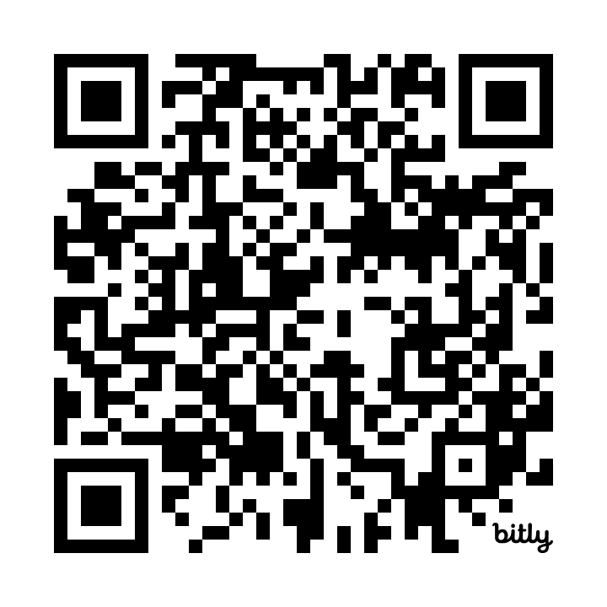



Contact, Connect, and Stay Informed
Contact & Connect
Stay Informed
bit.ly/NCADEMI-notifications
  ncademi.org
  info@ncademi.org
  435.554.8213 (voice or text)
  Follow us on LinkedIn

Slide 26


Disclaimers
The contents of this slide deck were developed under a cooperative agreement with the U.S. Department of Education, Office of Special Education Programs, Award No. H327Z240007. However, those contents do not necessarily represent the policy of the Department of Education, and you should not assume endorsement by the Federal Government. Project Officer: Rebecca Sheffield, Ph.D.
The contents of this slide deck are licensed under a Creative Commons Attribution-ShareAlike 4.0 International License (CC BY-SA 4.0).
ncademi.org | info@ncademi.org

Slide 27
Q&A

