Slide 1
Welcome! The webinar will begin promptly.
Feel free to introduce yourself in the chat while we wait, such as:
Your name
Your role
Your location
The reason you chose to attend today’s webinar

Slide 2
Get to Know the New National Center on Accessible Digital Educational Materials & Instruction
January 21, 2025

Slide 3
Webinar Communication
Please use the Zoom Q&A for any questions for the presenters.
Use Zoom Chat to communicate with other attendees and share resources.
We’ve allotted time at the end of the webinar for live Q&A. At that time, use the React button to raise your hand to unmute and use your microphone.

Slide 4
Webinar Resources
Slide deck is available at bit.ly/GTK-NCADEMI.
Recording and a Q&A summary will be available tomorrow on that same resources page.

Slide 5
Today's NCADEMI Facilitators
Dr. Brenda Smith, Principal Investigator
Cynthia Curry, Project Director
Christopher Phillips, Technical Assistance Specialist
Jena Fahlbush, Technical Assistance Specialist
Supporting Team Members: Rob Carr, Digital Accessibility Specialist & Natalie Cardenas, Program Assistant

Slide 6
Webinar Objectives
You will know:
What and where NCADEMI is.
Why NCADEMI is needed.
How NCADEMI can help you and your organization.
How you can get involved right now.

Slide 7
Poll Question

Slide 8
About Us

Slide 9
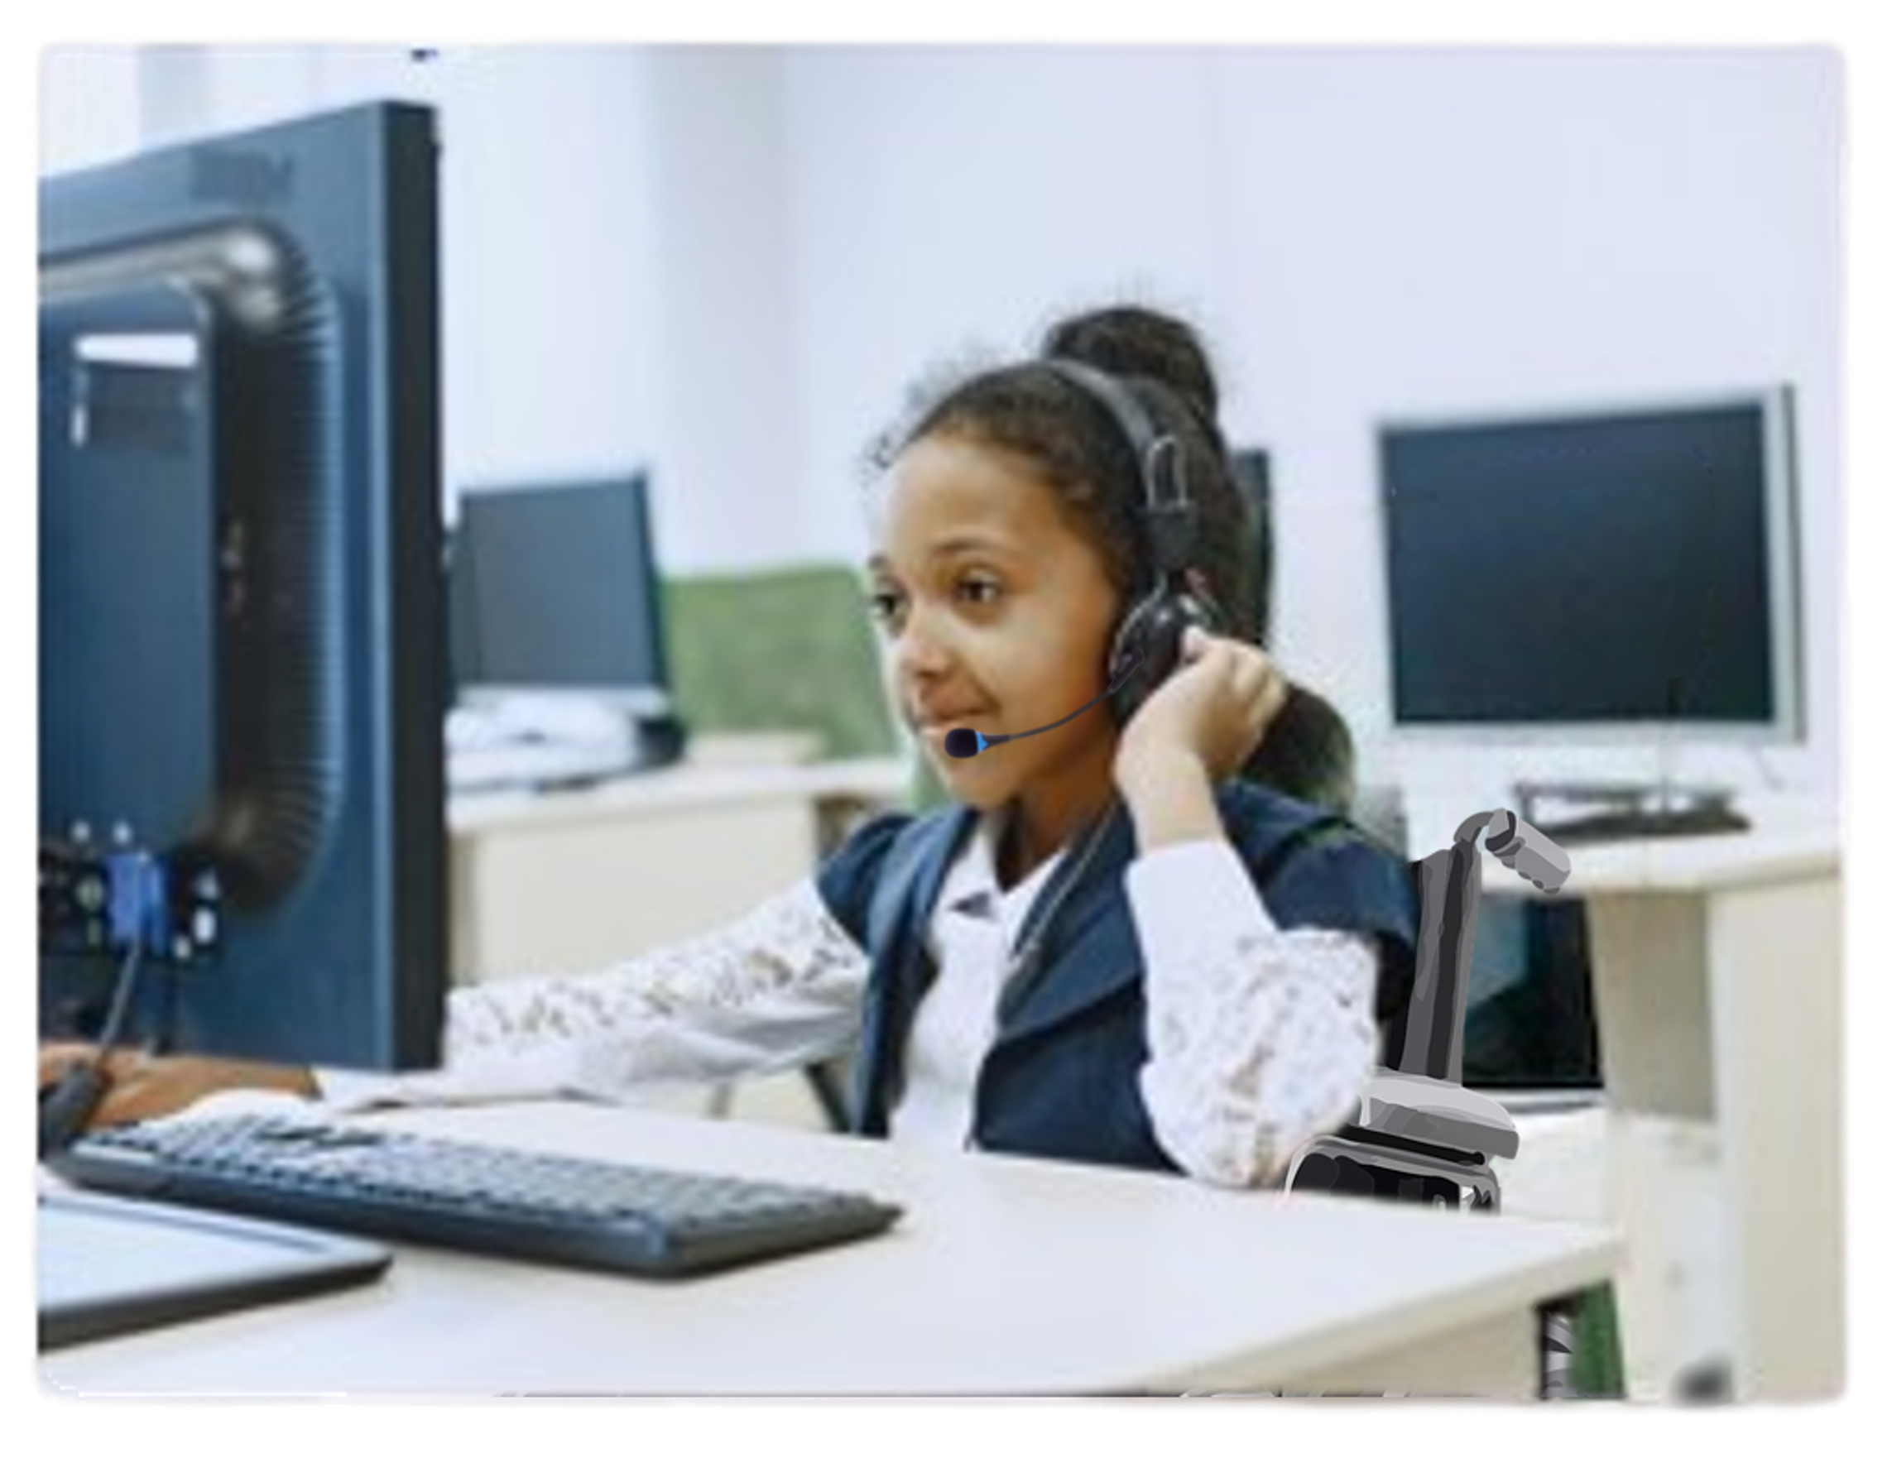
NCADEMI (“n-cademy”)
A new technical assistance (TA) center funded by the U.S. Department of Education's Office of Special Education Programs (OSEP) to improve the quality, availability, and timely provision of accessible digital educational materials and instruction for learners with disabilities from preschool through high school graduation.

Slide 10
Our Homebase
A project at Utah State University​
Administered within Utah’s University Center for Excellence in Developmental Disabilities - the Institute for Disability Research, Policy & Practice (IDRPP)
A partnership between Web Accessibility in Mind (WebAIM) and Technical Assistance for Excellence in Special Education (TAESE)​ within the IDRPP

Slide 11
Meet Our Team
The NCADEMI team consists of:
A Leadership Team with decades of technical assistance and digital accessibility experience
Seven Technical Assistance Specialists
Three Digital Accessibility Specialists
An administrative team handling project management, graphic design, instructional technology, communication & dissemination, technical writing, and website development

Slide 12
Why a national TA center dedicated to digital accessibility?

Slide 13
Students with disabilities have a right to accessible digital educational materials and instruction.
State and local educational agencies are required to provide them in a timely manner.

Slide 14
Related Laws
Digitally Accessible from the Beginning for Everyone
ADA Title II
Retrofitted for Accessibility for Eligible Students
IDEA

Slide 15
Accessibility in Action
An element you can begin using or improve today!

Slide 16
Color Contrast
Which color combination do you prefer? (light gray on white)
Which color combination do you prefer? (yellow on black)
Which color combination do you prefer? (red on white)
Which color combination do you prefer? (light blue on dark blue)
Which color combination do you prefer? (black on white)

Slide 17
Use High Color Contrast
Contrast must be sufficient:
4.5:1 ratio of text color to background color, or
3:1 ratio of text color to background color for text that’s 14pt and bold or 18pt.
Remember contrast in hyperlinks, charts, graphs, forms, and images!

Slide 18
Check contrast with WebAIM’s Contrast Checker:
webaim.org/resources/contrastchecker

Slide 19
Who We Serve

Slide 20
What is “Technical Assistance or TA”?
Evidence-based:
Relationship building
Training
Coaching
Presenting
Facilitating
Research
Publications
(Lots of) Dissemination
Image by Manfred Steger from Pixabay

Slide 21
2 Tiers of TA
Universal TA
Targeted TA
“General TA and information provided to independent users through their own initiative, resulting in minimal interaction with TA project staff.”
“Specialized TA services based on needs common to multiple recipients and not extensively individualized. A relationship is established between the TA recipient and one or more TA project staff.”

Slide 22
Targeted TA Recipients
State & Local Educational Agencies (SEAs & LEAs)
Part C Lead Agencies
Parent Information Centers
Pre- & In-service Teacher and Administrator Prep Programs
OSEP Technical Assistance & Dissemination (TA&D) Centers

Slide 23
SEAs and LEAs
We help SEAs and LEAs improve the provision and use of accessible digital educational materials and instruction through five innovations:
Evaluate: Apply criteria to determine the extent to which a digital material conforms to relevant accessibility specifications.
Procure: Solicit accessible digital materials at agency scale.
Select: Identify an accessible digital material at school or practitioner level.
Create: Prepare accessible digital materials at the school or practitioner level.
Use: Means by which students with disabilities use accessible materials.

Slide 24
Part C Lead Agencies
We help Part C lead agencies and early intervention service providers prepare infants and toddlers with disabilities and their families to use materials provided in Part B early childhood education programs and preschools.

Slide 25
Parent Information Centers
We help parent centers to better prepare parents and caregivers to communicate the digital accessibility needs of their children with disabilities.
Parent Training & Information Centers
Community Parent Resource Centers
Parent Technical Assistance Centers

Slide 26
Pre- & In-service Prep Programs
We help pre- and in-service preparation programs better prepare teacher and administrator candidates to provide and use accessible digital educational materials upon program completion and induction to their new roles.

Slide 27
OSEP TA&D Centers
We help OSEP TA&D Centers and other OSEP projects improve the accessibility of their digital products and services.
Websites
Publications
Videos
Videoconferences
Web-based tools and apps

Slide 28
Training & TA Resources Currently Available

Slide 29
Webinar Recordings
Act Now: Understanding New PreK-12 Digital Accessibility Requirements​
The Intersection of Special Education and New PreK-12 Digital Accessibility Requirements
Get to Know NCADEMI – Recording coming soon!

Slide 30
Resources & Publications
Find Your State Accessible Educational Materials (AEM) Contact
Meeting the ADA Title II Web and Mobile Accessibility Requirements: A Roadmap for State and Local Educational Agencies​
More to the Myths and Facts: Addressing Accessible Educational Materials in the 2024 Assistive Technology Guidance
NIMAS & NIMAC: What SEAs and LEAs Need to Know

Slide 31
Training & TA Resources Under Development

Slide 32
Resources to Look Forward to!
Updated website with audience-specific content
Microcredentials on specific accessibility topics
Searchable clearinghouse of vendor product accessibility
Quality Indicators for Providing Accessible Digital Educational Materials & Instruction

Slide 33
National Digital Accessibility Needs Assessment

Slide 34
We Need Your Input!
ncademi.org/input ​
Surveys for representatives of SEAs, LEAs, Part C lead agencies & early intervention programs, parent centers, pre-service programs, and OSEP centers​
Virtual listening tour for SEAs & LEAs

Slide 35
Conferences
Come see us at ATIA 2025 in Orlando FL next week and SXSW EDU in Austin TX, March 3-6!

Slide 36
Contact, Connect, and Stay Informed
Contact & Connect
Stay Informed
ncademi.org
ncademi@usu.edu
435.554.8213 (voice or text)
Follow us on LinkedIn
ncademi.org/newsletter

Slide 37
Q&A

Slide 38
Disclaimers
The contents of this slide deck were developed under a cooperative agreement with the U.S. Department of Education, Office of Special Education Programs, Award No. H327Z240007. However, those contents do not necessarily represent the policy of the Department of Education, and you should not assume endorsement by the Federal Government. Project Officer: Rebecca Sheffield, Ph.D.
The contents of this slide deck are licensed under a Creative Commons Attribution-ShareAlike 4.0 International License (CC BY-SA 4.0).
ncademi.org | ncademi@usu.edu

