Slide 1
"Coordinating with the NIMAC: What It Means – and Why It’s Important" will begin at 2pm ET
Feel free to introduce yourself in the chat while we wait. You may include:
Name
Role
Location
The reason you chose to attend today’s webinar

Slide 2
Webinar Communication
Please use the Zoom Q&A for any questions for the presenters.
Use Zoom Chat to communicate with other attendees and share resources.
We’ve allotted time at the end of the webinar for live Q&A. At that time, use the React button to raise your hand to unmute and use your microphone.

Slide 3
Webinar Accessibility & Resources
Captioning and ASL
Slide deck is available at: bit.ly/coordinate-nimac
Recording will be available tomorrow on that same web page.

Slide 4
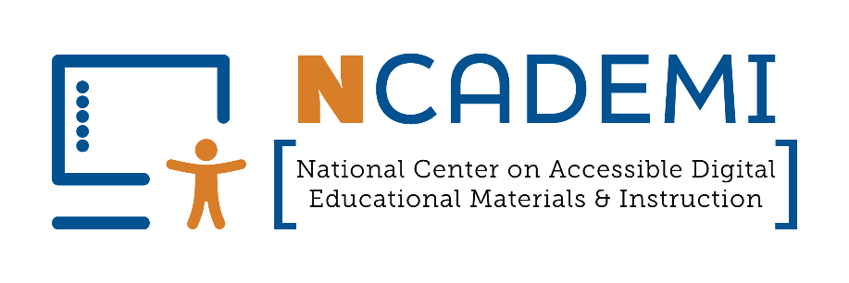
Coordinating with the NIMAC: What It Means – and Why It’s Important
NIMAC Nicole Gaines
ngaines@aph.org
Liz Schaller
eschaller@aph.org
April 2025
NCADEMI Cynthia Curry
cynthia.curry@usu.edu
Jena Fahlbush
jena.fahlbush@usu.edu

Slide 5
Audience Question 1
What is your level of knowledge about NIMAS and working with the NIMAC? Please respond with a number:
No knowledge
Somewhat familiar
Experienced
Expert
Notes:
What is your level of knowledge about NIMAS and working with the NIMAC?

Slide 6
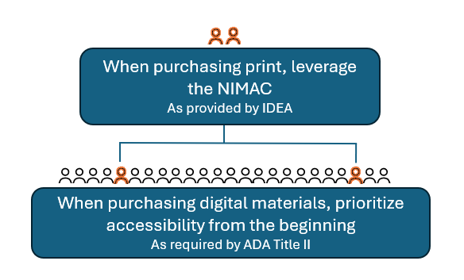
Accessibility in Purchasing

Slide 7
Save the Date!
NCADEMI Webinar: Including Accessibility in Your Ed Tech Decisions
Date: Wednesday, May 7
Time: 2:00 - 2:45 p.m. ET
Register today!

Slide 8
What is the NIMAC?

Slide 9
The NIMAC
Created by IDEA 2004, the National Instructional Materials Access Center (NIMAC) is the national “source file” repository for K-12 textbooks and instructional materials.
The NIMAC receives digital files from publishers in a special format (NIMAS).
Registered users log in and download these files, as needed, to produce accessible formats such as braille, large print, or digital text on behalf of eligible students.

Slide 10
The Goal of NIMAS/NIMAC
Goal: to support the timely delivery of accessible formats to students by preventing delays at the start of accessible format production.
When an accessible media producer can immediately download the source file they need from the NIMAC, work can begin immediately on production of the format the student needs.

Slide 11
The NIMAC Today
The NIMAC works with over 210 educational publishers and has received over 83,000 files.
The NIMAC has over 500 Authorized Users and accessible media producers registered across all the states.
NIMAC users have downloaded files over 56,000 times for use in the first-time production of one or more accessible formats.

Slide 12
What are NIMAS files?

Slide 13
NIMAS Format
IDEA also created the NIMAS source file format.
This format is not distributed directly to students.
NIMAS must be converted into an accessible format – such as braille, large print, digital text, or digital audio – before use.

Slide 14
One Source File, Many Formats
Braille
Large Print
DAISY
Digital Audio
EPUB
Other digital formats
NIMAS

Slide 15
Student Eligibility
A wide range of students are eligible to receive accessible formats produced from NIMAS.
Students with reading disabilities, such as dyslexia
Students with physical disabilities
Students who are blind or low vision

Slide 16
NIMAS in IDEA
Under IDEA 2004, States are not required to coordinate with the NIMAC, but they are required to “adopt” the NIMAS source file format.
This means States have two options:
They can obtain NIMAS files directly from publishers for use in producing braille and other accessible formats or
They can coordinate with the NIMAC.

Slide 17
Coordination with NIMAC
The NIMAC works with all 50 states, the 6 eligible territories and DoDEA.
All 50 states have continuously coordinated with the NIMAC for at least the past 15 years (and some earlier).

Slide 18
What does it mean for a state to coordinate with the NIMAC?

Slide 19
What Coordination Means
States that coordinate agree to:
Designate a State Coordinator to add and remove Authorized Users for the state, as needed (usually 5 or fewer).
Ensure that the SEA requires publishers to submit files to the NIMAC as a part of any instructional materials procurement process or contract.
Abide by NIMAC eligibility criteria and limitations of use as outlined in the NIMAC Coordination Agreement.

Slide 20
NIMAS & Procurement
Under IDEA 2004, there is no blanket requirement for publishers to submit files to the NIMAC.
The only mechanism to require NIMAS from the publisher is the book adoption contract or purchase agreement.
Including NIMAS language in all SEA and LEA contracts is essential to ensuring that the NIMAC will receive the files students need.

Slide 21
Why is it beneficial for states to coordinate with the NIMAC?

Slide 22
Benefits of Coordinating
Access to 83,000 NIMAS files in a central online system that can be accessed 24/7, 365 days a year (instead of requesting files from individual publishers each time an accessible format needs to be produced).
Access on behalf of your students to thousands of NIMAC-sourced materials produced by agencies across the U.S.

Slide 23
What does it mean for a district to opt-in on the IDEA assurances?

Slide 24
The NIMAC and Districts
LEAs do not submit any coordination paperwork to the NIMAC – they only indicate their opt-in status in their IDEA assurances to the SEA.
We strongly encourage all LEAs to coordinate.
Not opting in means LEAs would deny access to NIMAS-sourced materials for their students, including those produced by agencies in their own state and national providers like Bookshare.

Slide 25
LEAs and Procurement
Under IDEA 2004, LEAs that opt in are also obligated to include the NIMAS requirement in any textbook purchase agreements. This is not optional.
It is essential that SEAs inform LEAs of this requirement and ensure that district procurement staff are aware of this legal obligation.

Slide 26
Sample Contract Language from NCADEMI
“By agreeing to deliver the materials marked with “NIMAS” on this contract or purchase order, the publisher agrees to prepare and submit on or before [month/day/year] a NIMAS fileset to the NIMAC that complies with the terms and procedures set forth by the National Instructional Materials Access Center (NIMAC) (IDEA Title I, Part D, sec. 674(e)).
The publisher also agrees to mark up materials eligible for NIMAS submission that contain mathematical and scientific instructional content by using the MathML modular extension of the DAISY/NIMAS Structure Guidelines, as posted and maintained at the DAISY Consortium website [refer to the latest applicable version].
Should the vendor be a distributor of the materials and not the publisher, the distributor agrees to immediately notify the publisher of its obligation to submit NIMAS filesets of the purchased materials to the NIMAC. The files will be used for the production of accessible formats as permitted under the law for eligible students (IDEA Title I, Part B, sec. 612(a)).”

Slide 27
Audience Question 2
Does your state provide guidance to districts on the NIMAS procurement requirement in IDEA? Please reply:
Yes
No
Unsure
Notes:
What is your level of knowledge about NIMAS and working with the NIMAC?

Slide 28
Does the NIMAC receive digital instructional materials?

Slide 29
NIMAS & Digital Materials
Since its inception, the NIMAC has been a resource primarily for print-based instructional materials.
In May of 2020, the Department published a Notice of Interpretation (NOI) permitting the NIMAC to accept NIMAS for some digital instructional materials.

Slide 30
NIMAS & Digital Materials – cont.
Only a subset of digital instructional materials can be converted into valid NIMAS format.
To be submitted, digital materials must be:
Composed primarily of static images and text
Have a linear reading order
Include minimal or no interactivity
Include minimal or no audio or video content
For more information, see our NIMAS & Digital Materials FAQ.

Slide 31
IDEA and ADA Title II
Under the NOI, digital instructional materials that meet WCAG 2.0 AA accessibility criteria are exempt from NIMAS requirements.
The NIMAC strongly encourages states and districts to comply with ADA Title II and acquire accessible digital instructional materials directly from publishers.

Slide 32
IDEA and ADA Title II - continued
When SEAs and LEAs require in procurement that digital instructional materials be accessible and that NIMAS be supplied for print-based materials, these two solutions work together to support access to the curriculum by all students:
NIMAS → Print-based materials
Title II → Digital educational materials

Slide 33
How can SEA and LEA staff learn more?

Slide 34
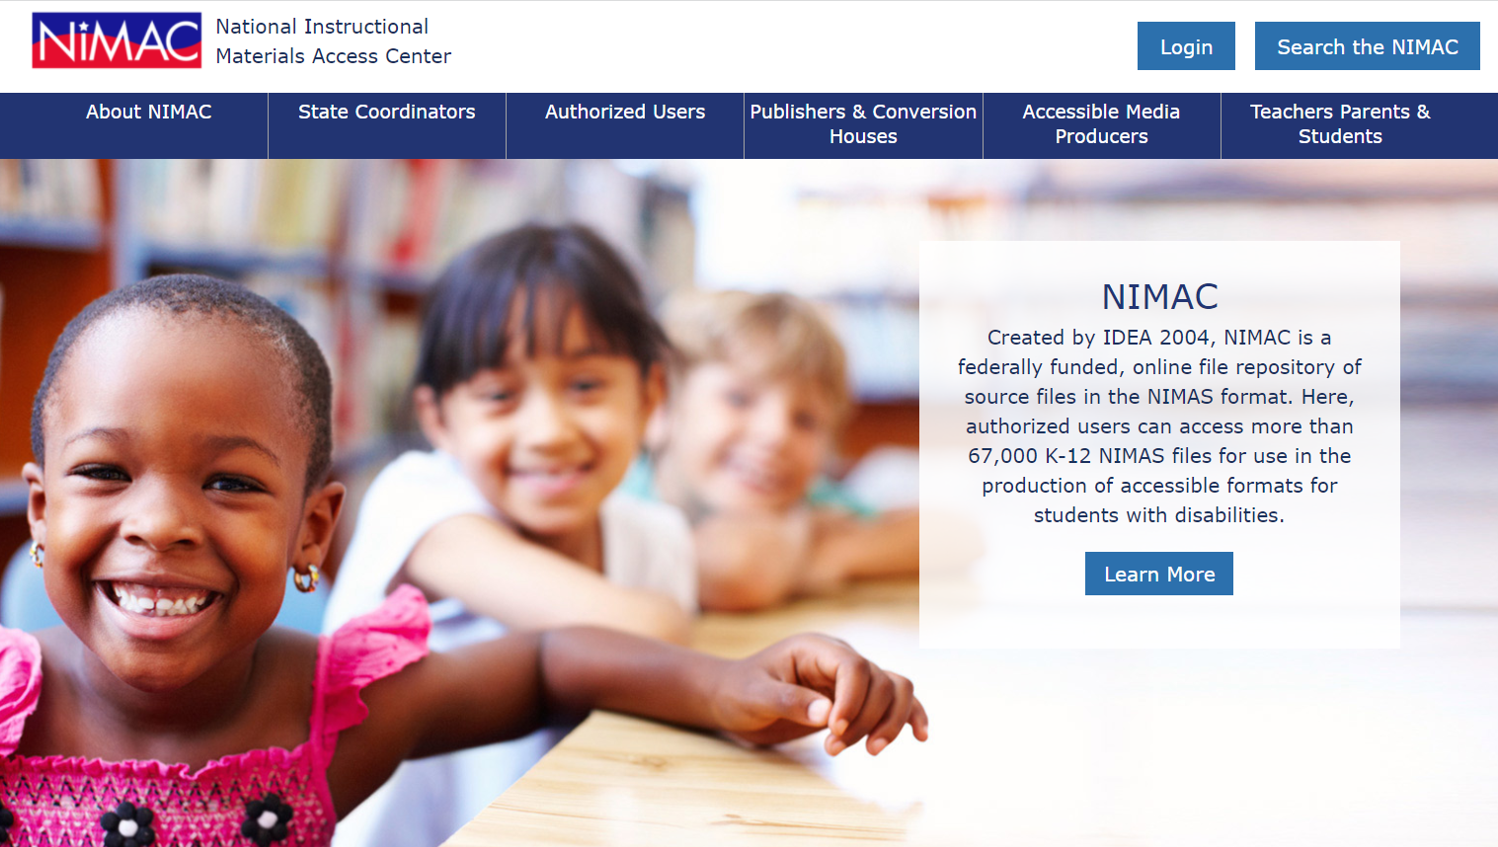
For more assistance . . .
Reach out to the NIMAC anytime:
nimac@aph.org
877-526-4622
nimac.us

Slide 35
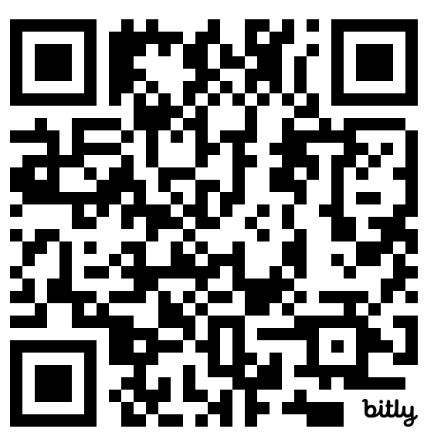
Contact, connect & stay connected with NCADEMI
Contact & Connect
ncademi.org
ncademi@usu.edu
435.554.8213 (voice or text)
Follow us on LinkedIn
Stay Informed
ncademi.org/newsletter

Slide 36
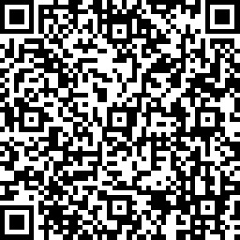
Your Feedback Matters!
bit.ly\webinar-survey4
Anonymous response
Less than 5 min!

Slide 37
Q&A

Slide 38
Survey
bit.ly\webinar-survey4
Anonymous response
Less than 5 min!

Slide 39
Disclaimers
The contents of this resource were developed under two grants from the US Department of Education, #H327E210001 and #H327Z240007. However, these contents do not necessarily represent the policy of the US Department of Education, and the reader should not assume endorsement by the Federal Government. Project Officer: Rebecca Sheffield.
The contents of this slide deck are licensed under a Creative Commons Attribution-ShareAlike 4.0 International License (CC BY-SA 4.0).

