Slide 1
More Myths & Facts: Let’s Talk About the Role of AEM in the 2024 AT Guidance
Cynthia Curry, MSEd
Jena Fahlbush, MEd

Slide 2
ACVREP CEU Session Start Code
If you do not plan to claim ACVREP CEUs (primarily for Vision Impairment Specialists), you do not need to note these codes.
Start Code:
This session has been approved for ACVREP CEUs. If you plan to claim ACVREP CEUs, please note this code, and the end code that will be shown at the end of this session.
Please visit atia.org/ceus-in-person for full information on how to claim CEUs.

Slide 3
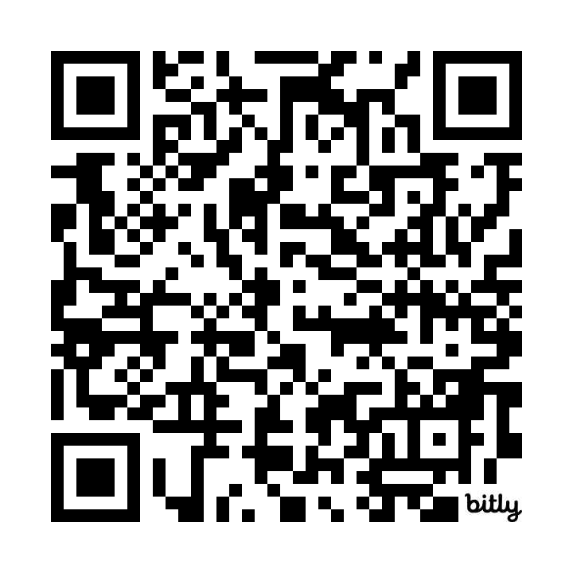
Session Resources
bit.ly/atia-more-myths

Slide 4
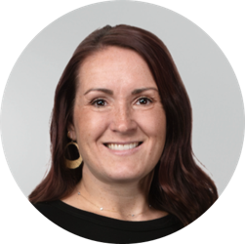
Greetings, Mythbusters!
Cynthia Curry
Project Director
Jena Fahlbush
Technical Assistance Specialist​

Slide 5
Get to Know NCADEMI

Slide 6
Speaker 1 Disclosure
Cynthia Curry receives a salary from employment at Utah State University. She is Project Director of a grant award from the U.S. Department of Education's Office of Special Education Programs. She also serves as an ATIA 2025 Strand Advisor, for which she receives an honorarium.

Slide 7
Speaker 2 Disclosure
Jena Fahlbush is an employee of Utah State University and works on a project federally funded by the U.S. Department of Education.

Slide 8
Let’s Get Going

Slide 9
Learning Objectives
Describe 2 examples of the relationships among assistive technology (AT), AEM, and accessible formats.
Explain 3 services associated with the provision of accessible formats.
Apply 2 IDEA requirements to the process of including accessible formats in a student’s IEP.

Slide 10
Session Overview
Definitions & background knowledge
Review More to the Myths and Facts document
Bust the Myths!
Questions & Wrap-Up

Slide 11
Accessible Educational Materials (AEM)​
“Print- and technology-based educational materials, including printed and electronic textbooks and related core materials that are required by SEAs and LEAs for use by all students, produced or rendered in accessible media, written and published primarily for use in early learning programs, elementary, or secondary schools to support teaching and learning.”​​
U.S. Department of Education, 2014 (footnote 10)​
Notes:
U.S. Department of Education. (2014, May 9). Notice of Intent to Establish a National Center on Accessible Educational Materials [Notice]. Federal Register, 79(90), 26677-26679.

Slide 12
Two Types of AEM
Accessible Digital Material
Accessible Format
Designed to be digitally accessible from the beginning
Procured or selected for use by all students
Produced by publishers and vendors
Converted from an inaccessible material
Acquired for use by an eligible student with a disability
Rendered by accessible media producers

Slide 13
Two Pathways to Provide AEM​
A student needs AEM
Provide digital materials produced to be accessible from the beginning
Provide materials rendered in accessible formats (e.g., braille, audio, large print)

Slide 14
Two Pathways to Provide AEM:​ Related Laws
A student needs AEM
Digitally Accessible from the Beginning for Everyone​
Americans with Disabilities Act (ADA) Title II
Retrofitted for Accessibility for Eligible Students​
IDEA

Slide 15
For More on ADA Title II
Navigating a New Landscape of Digital Accessibility Requirements in K-12
Friday at 1:00pm
Grand Ballroom 5/6
Presented by Rob Carr & Christopher Phillips

Slide 16
2024 AT Guidance
Published jointly by Office of Educational Technology and Office of Special Education Programs
Increase understanding of the IDEA’s requirements regarding AT
Dispel common misconceptions
Provide examples of the use of AT

Slide 17
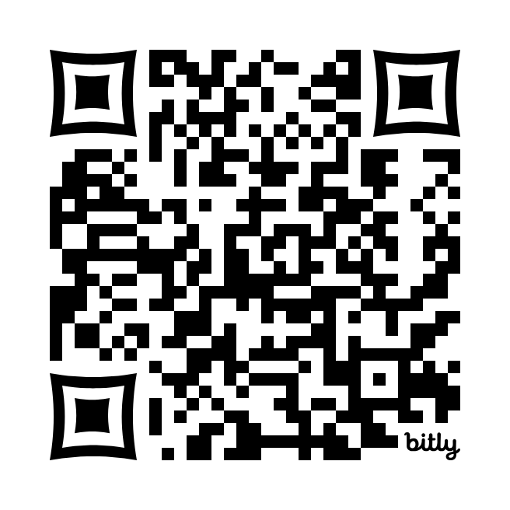
More to the Myths and Facts: Addressing AEM in the 2024 Assistive Technology Guidance
ncademi.org/aem-guide

Slide 18
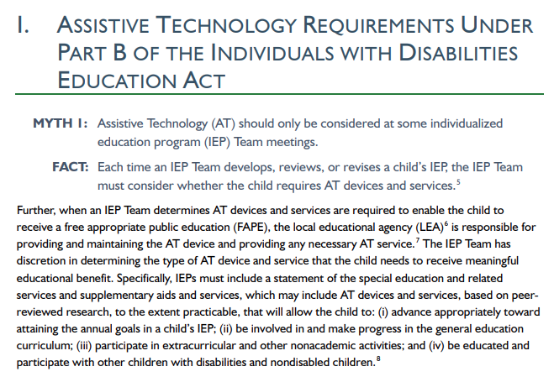
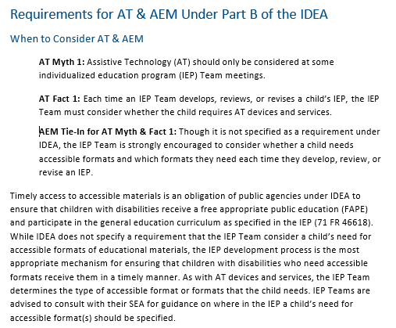
Side-by-Side: AT Guidance & NCADEMI AEM Supplement

Slide 19
Bust the Myths!

Slide 20
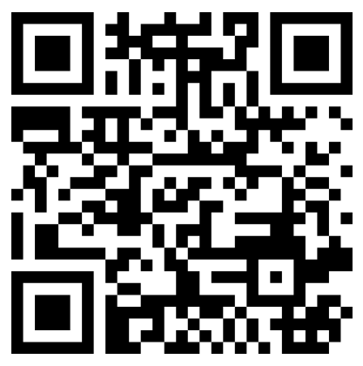
Join In!
Join at menti.com Code 1848 1749
Keep track using your preferred method

Slide 21
Fact or Myth 1-2
Accessible formats should only be considered at some individualized education program (IEP) Team meetings.
An accessible format evaluation must be conducted prior to providing an accessible format to a child with a disability.

Slide 22
Fact or Myth 3-5
Children can learn to use accessible formats on their own; educators have no obligation to provide training to a child or their family.
Accessible formats cannot be used for participation in State academic assessments.
Accessible formats and services should only be considered for children with certain disabilities.

Slide 23
Fact or Myth 6-7
Acquiring accessible formats takes a long time and won’t give timely services to the child as required.
Infants, toddlers, and families served under IDEA Part C do not benefit from accessible formats.

Slide 24
Myth Busting Discussion

Slide 25
Myth #1
Assistive Technology
Accessible Formats
AT should only be considered at some individualized education program (IEP) Team meetings.
Accessible formats should only be considered at some individualized education program (IEP) Team meetings.

Slide 26
AEM Tie-In for AT Fact 1
Though it is not specified as a requirement under IDEA, the IEP Team is strongly encouraged to consider whether a child needs an accessible format and which format(s) they need each time they develop, review, or revise an IEP.
Notes:
Photo from Pexels: https://www.pexels.com/photo/gorup-of-employees-working-together-3182759/

Slide 27
Myth #4
Assistive Technology
Accessible Formats
An AT evaluation must be conducted prior to providing an AT device and service to a child with a disability.
An accessible format evaluation must be conducted prior to providing an accessible format to a child with a disability.

Slide 28
AEM Tie-In for AT Fact 4
Unless a child is blind or visually impaired, IDEA does not specify requirements for an accessible format evaluation.
Notes:
Photo from Pexels: https://www.pexels.com/photo/a-person-using-a-braille-book-7307943/

Slide 29
Myth #5
Assistive Technology
Accessible Formats
Children can learn to use an AT device on their own; educators have no obligation to provide training to a child or their family.
Children can learn to use accessible formats on their own; educators have no obligation to provide training to a child or their family.

Slide 30
AEM Tie-In for AT Fact 5
Services may be required to support a child’s use of accessible formats to effectively participate in the general education curriculum as specified in the IEP.
Photo courtesy of Alexis Spence, Utah State University

Slide 31
Myth #8
Assistive Technology
Accessible Formats
AT cannot be used for participation in State academic assessments.
Accessible formats cannot be used for participation in State academic assessments.

Slide 32
AEM Tie-In for AT Fact 8
Appropriate accommodations for State assessments include providing the assessment in an accessible format for a child with a disability who requires it.
Notes:
Photo from Pexels: https://www.pexels.com/collections/multiracial-education-1don8c6/

Slide 33
Myth #10
Assistive Technology
Accessible Formats
AT devices and services should only be considered for children with certain disabilities.
Accessible formats should only be considered for children with certain disabilities.

Slide 34
AEM Tie-In for AT Fact 10
Accessible formats should be considered for all children with IEPs.
Notes:
Photo from Pexels - https://www.pexels.com/photo/a-two-girls-using-laptop-with-classmates-5212697/

Slide 35
Myth #19
Assistive Technology
Accessible Materials
Buying AT devices takes a long time and won’t give timely services to the child as required.
Acquiring accessible formats takes a long time and won’t give timely services to the child as required.

Slide 36
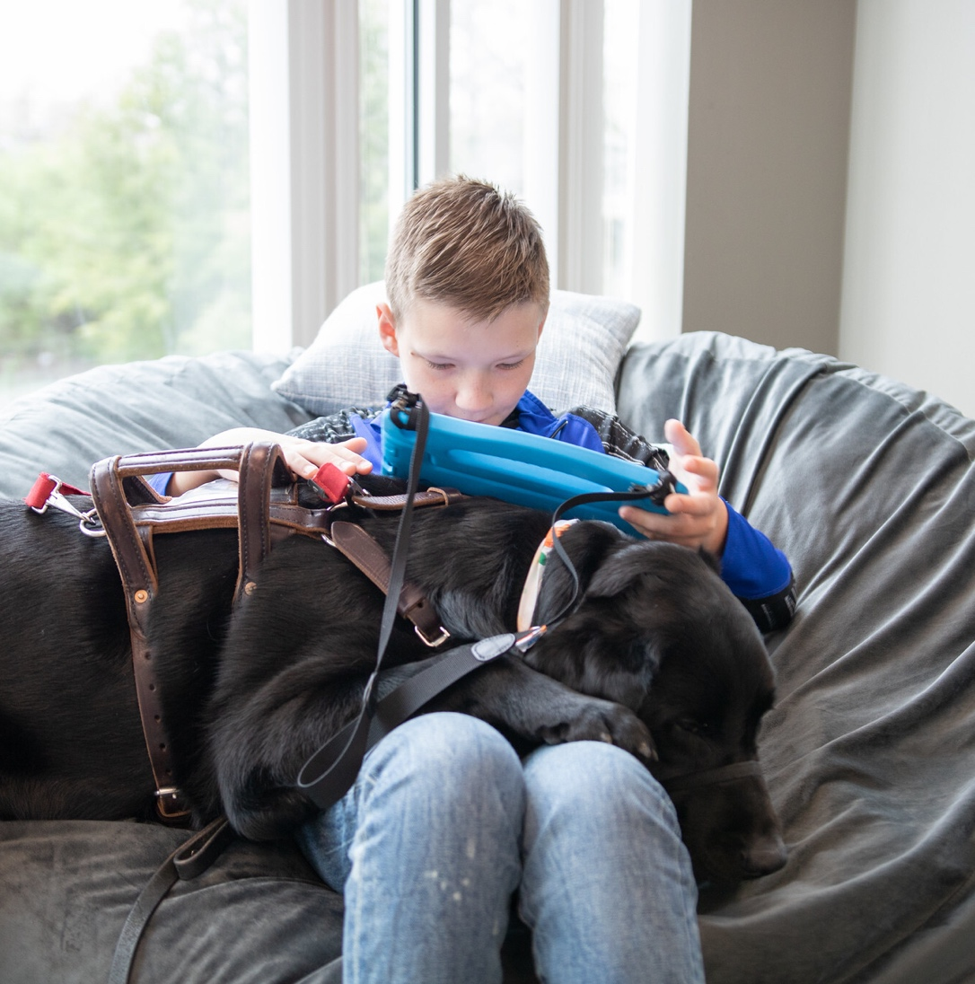
AEM Tie-In for AT Fact 19
As with AT devices, accessible formats should be made available to the child in accordance with the child’s IEP as soon as possible following the development of the IEP if they are required as part of the child’s special education or related services.
Notes:
Photo from Flickr: https://www.flickr.com/photos/198826134@N02/53084278271/in/album-72177720310182456

Slide 37
Myths #23-26
Assistive Technology
Accessible Materials
Infants, toddlers, and families served under IDEA Part C do not benefit from AT devices and services.
Infants, toddlers, and families served under IDEA Part C do not benefit from accessible formats.

Slide 38
AEM Tie-In for AT Facts 23-26
The IDEA requirements related to accessible formats are specific to Part B. However, there are accessibility-related considerations that parents and providers can make while an infant or toddler is receiving Part C services.
Notes:
Photo from Pexels: https://www.pexels.com/photo/a-woman-looking-at-her-baby-while-playing-a-toy-8910482/

Slide 39
Questions

Slide 40
We Need Your Input!
NCADEMI’s National Digital Accessibility Needs Assessment:
Surveys for representatives of state and local educational agencies, Part C lead agencies & early intervention programs, parent centers, pre-service programs, and OSEP centers
Virtual Listening Tour for states & school districts
ncademi.org/input

Slide 41
Joy Zabala Fellowship

Slide 42
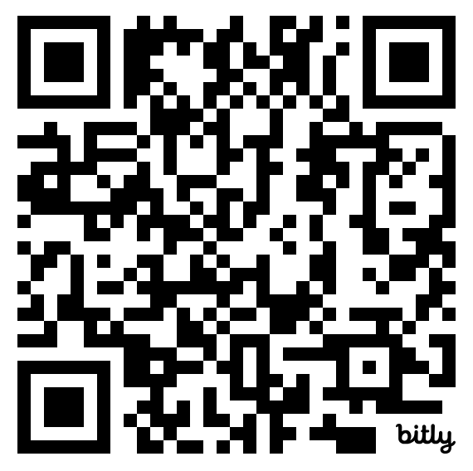
Contact, Connect, and Stay Informed
Contact & Connect
ncademi.org
ncademi@usu.edu
435.554.8213 (voice or text)
Follow us on LinkedIn
Stay Informed
ncademi.org/newsletter

Slide 43
Session Evaluation and CEUs
Session Feedback Evaluation
Your Feedback is very important to us. Please be sure to complete session evaluations through the ATIA mobile app.
CEUs
ATIA 2025 education presentations are reviewed for ASHA, ACVREP, AOTA, CRC and IACET CEU eligibility. Not all sessions are approved for each specialty CEU.
You must complete a CEU assessment for each session and CEU type you’d like to claim prior to the deadline.
In-person deadline to claim CEUs: February 28, 2025
Virtual Event deadline to claim CEUs: April 30, 2025
Please visit: atia.org/ceus-in-person

Slide 44
Disclaimers
The contents of this slide deck were developed under a cooperative agreement with the U.S. Department of Education, Office of Special Education Programs, Award No. H327Z240007. However, those contents do not necessarily represent the policy of the Department of Education, and you should not assume endorsement by the Federal Government. Project Officer: Rebecca Sheffield, Ph.D.
The contents of this slide deck are licensed under a Creative Commons Attribution-ShareAlike 4.0 International License (CC BY-SA 4.0).

Slide 45
ACVREP CEU Session End Code
If you do not plan to claim ACVREP CEUs (primarily for Vision Impairment Specialists), you do not need to note these codes.
End Code:
This session has been approved for ACVREP CEUs. If you plan to claim ACVREP CEUs, please note this code, and the start code that will be shown at the beginning of this session.
Please visit atia.org/ceus-in-person for full information on how to claim CEUs.

Slide 46
Thank You
Thank You

