Slide 1
Navigating a New Landscape of Digital Accessibility Requirements in K-12
Rob Carr
Christopher Phillips
Notes:
Christopher

Slide 2
ACVREP CEU Session Start Code
If you do not plan to claim ACVREP CEUs (primarily for Vision Impairment Specialists), you do not need to note these codes.
Start Code: green19
This session has been approved for ACVREP CEUs. If you plan to claim ACVREP CEUs, please note this code, and the end code that will be shown at the end of this session.
Please visit atia.org/ceus-in-person for full information on how to claim CEUs.

Slide 3
Presenters – Hello!
Rob Carr Digital Accessibility Specialist
Christopher Phillips Technical Assistance Specialist
Notes:
Both of Us

Slide 4
Speaker Disclosure
Rob Carr's position is partially funded by the National Center for Accessible Educational Materials and Instruction (NCADEMI). Christopher Phillips is fully employed by NCADEMI at Utah State University.
Rob is also co-strand advisor for the Mainstream and Accessible Technologies Strand at ATIA, and ATIA helps with expenses for the conference.
Notes:
Both

Slide 5
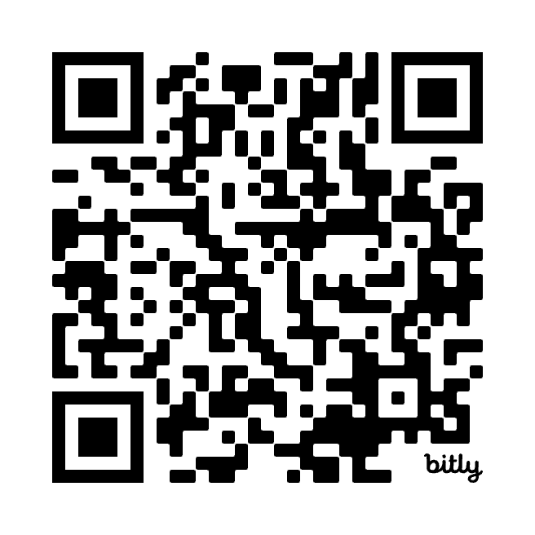
Session Resources
bit.ly/atia-2025
Notes:
Rob

Slide 6
Learning Objectives
Define three or more characteristics of accessible digital educational materials and instruction (ADEM&I).
Explain one or more requirements on schools to provide ADEM&I for students with disabilities.
Describe three ways NCADEMI provides technical assistance to states, districts, educators and service providers, families, and pre-service education programs.
Notes:
Rob

Slide 7
Session Overview
About NCADEMI
Why is NCADEMI needed?
Examples of digital educational technology
Resources available to help you today.
Resources coming in the future
Please help us understand what you need!
Notes:
Rob

Slide 8
About NCADEMI ("n-cademy")
A new technical assistance (TA) center funded by the U.S. Department of Education's Office of Special Education Programs (OSEP) to improve the quality, availability, and timely provision of accessible digital educational materials and instruction for learners with disabilities from preschool through high school graduation.
Notes:
Christopher

Slide 9
Home Base
Located at Utah State University in the Institute for Disability Research, Policy & Practice (IDRPP).
Collaboration with Web Accessibility in Mind (WebAIM) and Technical Assistance for Excellence in Special Education (TAESE).
Notes:
Christopher

Slide 10
NCADEMI Partners
Notes:
Christopher

Slide 11
Why NDACEMI?
Students with disabilities have a right to accessible digital educational materials and instruction.
State and local educational agencies are required to provide them in a timely manner. ​​
Notes:
Rob

Slide 12
How can NCADEMI Help?
Provide technical assistance with accessible educational materials and accessibility
IDEA and Section 504
Recent updates to Title II of the Americans with Disabilities Act
Notes:
Rob
Focus changes to proactive

Slide 13
Digital Educational Technology
Websites & Digital Textbooks
Online Courses, Apps, & Tools
Videos & Slide Presentations
Teacher-created & -curated materials
Notes:
Rob

Slide 14
Accessibility in Ed Tech
Does not meet every need
Creates equivalent experiences
Captions
Good color contrast
Alternative text
Heading styles
Notes:
Rob

Slide 15
What is "Technical Assistance" (TA)?
Evidence Based:
Relationship Building
Training
Coaching
Presenting
Facilitating
Research
Publications
Dissemination
Notes:
Christopher

Slide 16
2 Tiers of TA
Universal TA
General TA and information provided to independent users through their own initiative, resulting in minimal interaction with TA project staff.
Targeted TA
Specialized TA services based on needs common to multiple recipients and not extensively individualized. A relationship is established between the TA recipient and one or more TA project staff.

Slide 17
What NCADEMI TA is Not
Remediation service
Your legal counsel
Educational technology endorser

Slide 18
Support for Specific Groups
"Targeted Technical Assistance" for:
State & Local Educational Agencies (SEAs & LEAs)
Part C Lead Agencies
OSEP Technical Assistance & Dissemination Centers
Parent Information Centers
Pre- & In-service Teacher and Administrator Prep Programs
Notes:
Christopher

Slide 19
Available Today!
Webinars
On the new ADA Title II regulations
On IDEA and Title II
On NCADEMI
Roadmap for State and Local Education Agencies
Notes:
Rob

Slide 20
Resources to Look Forward to!
Updated website with audience-specific content
Microcredentials on specific accessibility topics
Searchable clearinghouse of vendor product accessibility
Quality Indicators for Providing Accessible Digital Educational Materials & Instruction
Notes:
Christopher

Slide 21
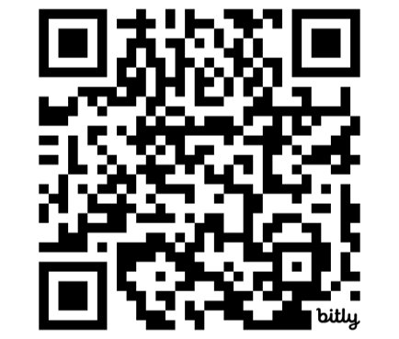
We Need Your Input!
ncademi.org/input
Surveys for representatives of SEAs, LEAs, Part C lead agencies & early intervention programs, parent centers, pre-service programs, and OSEP centers​
Virtual listening tour for SEAs & LEAs

Slide 22
Questions

Slide 23
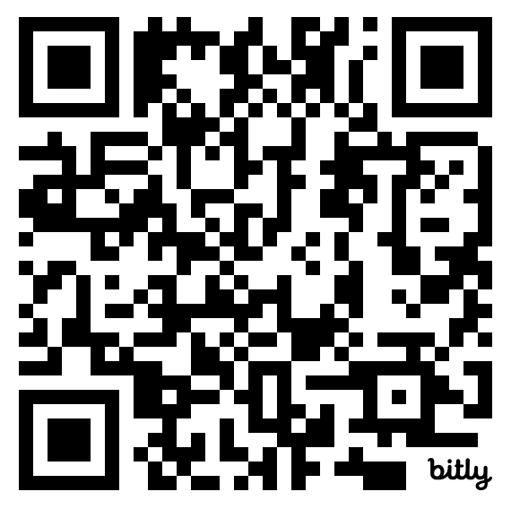
Contact, Connect, and Stay Informed
Contact & Connect
ncademi.org
ncademi@usu.edu
435.554.8213 (voice or text)
Follow us on LinkedIn
Stay Informed
ncademi.org/newsletter

Slide 24
Session Evaluation and CEUs
Session Feedback Evaluation
Your Feedback is very important to us. Please be sure to complete session evaluations through the ATIA mobile app.
CEUs
ATIA 2025 education presentations are reviewed for ASHA, ACVREP, AOTA, CRC and IACET CEU eligibility. Not all sessions are approved for each specialty CEU.
You must complete a CEU assessment for each session and CEU type you’d like to claim prior to the deadline.
In-person deadline to claim CEUs: February 28, 2025
Virtual Event deadline to claim CEUs: April 30, 2025
Please visit: atia.org/ceus-in-person

Slide 25
Disclaimers
The contents of this slide deck were developed under a cooperative agreement with the U.S. Department of Education, Office of Special Education Programs, Award No. H327Z240007. However, those contents do not necessarily represent the policy of the Department of Education, and you should not assume endorsement by the Federal Government. Project Officer: Rebecca Sheffield, Ph.D.
The contents of this slide deck are licensed under a Creative Commons Attribution-ShareAlike 4.0 International License (CC BY-SA 4.0).

Slide 26
ACVREP CEU Session End Code
If you do not plan to claim ACVREP CEUs (primarily for Vision Impairment Specialists), you do not need to note these codes.
End Code: green20
This session has been approved for ACVREP CEUs. If you plan to claim ACVREP CEUs, please note this code, and the start code that will be shown at the beginning of this session.
Please visit atia.org/ceus-in-person for full information on how to claim CEUs.

Slide 27
Thank You
Thank You

