Slide 1
Including Accessibility in Your EdTech Decisions
May 7, 2025

Slide 2
Webinar Communication
Use Zoom Chat to communicate with other attendees and share resources.
Please use the Zoom Q&A for any questions for the presenters as we’ve allotted time at the end of the webinar for live Q&A.

Slide 3
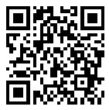
Webinar Accessibility & Resources
Captioning
Slide deck is available at tinyurl.com/edtech-procurement
Recording will be available tomorrow on that same resources page
Notes:
Rob

Slide 4
Today’s Presenters:
Rob Carr Digital Accessibility Specialist, NCADEMI
Christopher Phillips Technical Assistance Specialist, NCADEMI
Aujalee Moore Standards Guidance Program Analyst, Oregon Dept. of Education

Slide 5
Integrate Accessibility in All Components of Procurement

Slide 6
Requests for Information & Requests for Proposals

Slide 7
Accessibility in Requests for Proposals
Consider accessibility from the very beginning
Emphasize the important of accessibility to the vendor
Set clear expectations

Slide 8
Scoring Matrix

Slide 9
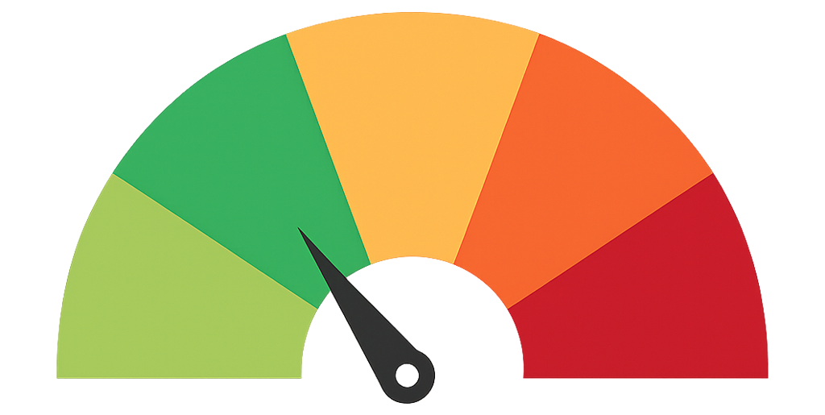
Scoring Accessibility
Lessen the chance that accessibility is set aside
Assign objective scores to vendor docs, communication
Align with any current product scoring

Slide 10
Contract Language

Slide 11
Clear Contract Language
Hold the vendor accountable
Specific expectation and timelines
What happens if you discover an accessibility barrier?

Slide 12
Vendor Accessibility Maturity Evidence

Slide 13
Big Picture View
Seek information about vendors' overall accessibility practice
Internal standards?
Internal professional development?
Accessibility expert on staff or contracted?
Specific accessibility contact?

Slide 14
Accessibility Conformance Reports

Slide 15
What is an Accessibility Conformance Report (ACR)?
The ACR is a representation of how the product meets the applicable Technical Standards.
The product owner/developer must first test the product against those standards in order to complete an ACR.
Currently, the most common way an ACR is completed is by using the VPAT® template
There are various levels of compliance that can be documented within the ACR.

Slide 16
Oregon's ACR Policy
OAR 581-011-0087 (Digital, Electronic, and Web-Based Materials) requires all publishers submitting materials to ODE’s evaluation to:
provide an up-to-date, complete, and accurate Accessibility Conformance Report (ACR)
Report must be completed by a third-party and include manual verification of testing.
OAR 581-022-2350 (Independent Adoption) requires districts independently adopting materials to:
Include an up-to-date, complete, and accurate Accessibility Conformance Report (ACR)
Health Instructional Materials Adoption as a pilot in 2024.
Notes:
Since 2020, there has been an increase in the adoption and implementation of digital instructional materials as the core component of instruction. As the instructional materials market has continued to evolve, so do accessibility standards. Since digital instructional materials are increasingly present in K-12 public schools, a rule revision is necessary to ensure that the administrative rules related to accessibility of instructional materials include reference to digital accessibility standards. ODE utilizes the National Instructional Materials Access Standards or NIMAS to assure adopted materials are accessible. However, NIMAS only adequately addresses print materials and static digital materials such as those contained within PDF file. NIMAS do not adequately address digital accessibility standards that are covered under the Web Content Accessibility Guidelines, also referred to as WCAG. Under current policy, ODE does not require an accessibility compliance report to be submitted for digital instructional material submissions, and we do not have staff who are responsible for verifying the adherence to accessibility requirements as it is the district’s responsibility to procure accessible materials. Reports from the field indicate that, while vendors are providing assurance of accessibility, the materials are not accessible when implemented with students. Additionally, there have been reports of challenges with providing students with alternate formats of materials in a timely manner, which can lead to civil rights violations. Although accessibility standards are required to be adhered to for both print and digital materials, former policy did not include reference to the Web Content Accessibility Guidelines (WCAG) which are required for digital content under Section 508 of the Rehabilitation Act. To accurately report alignment to the WCAG, an Accessibility Conformance Report (ACR) is necessary. An ACR describes how the item(s) will fully address the accessibility requirements outlined in the most current version of WCAG, and includes a description of the evaluation methods used to validate for conformance. For this reason, ODE revised two administrative rules related to instructional materials adoption to require publishers of digital instructional materials to provide an up-to-date, complete, and accurate Accessibility Conformance Report (ACR) that has been completed by a third-party and includes manual verification of testing.

Slide 17
Demonstrations

Slide 18
Demonstrate Tool Accessibility
Schedule time to review accessibility with the vendor
Basic test – keyboard navigation, video captions
Run a tool like WAVE for browser-based tools

Slide 19
Integrate Accessibility into Procurement
Embed accessibility requirements in these existing agency components:
RFIs & RFPs
Scoring Matrix
Contract Language
Add these components as vendor requirements to find evidence of accessibility:
Accessibility Maturity Evidence
ACRs
Demonstrations

Slide 20
Your Feedback Matters!
tinyurl.com/webinar-survey6
Anonymous response
Less than 5 min!

Slide 21
Questions?

Slide 22
We Want to Hear About Your Needs
Contact & Connect
Stay Informed
ncademi.org
ncademi@usu.edu
435.554.8213 (voice or text)
Follow us on LinkedIn
bit.ly/NCADEMI-notifications

Slide 23
Survey
tinyurl.com/webinar-survey6
Anonymous response
Less than 5 min!

Slide 24
Disclaimers
The contents of this slide deck were developed under a cooperative agreement with the U.S. Department of Education, Office of Special Education Programs, Award No. H327Z240007. However, those contents do not necessarily represent the policy of the Department of Education, and you should not assume endorsement by the Federal Government. Project Officer: Rebecca Sheffield, Ph.D.
The contents of this slide deck are licensed under a Creative Commons Attribution-ShareAlike 4.0 International License (CC BY-SA 4.0).
ncademi.org | ncademi@usu.edu

