Slide 1
NCADEMI and OCALI AT&AEM Center Braille Accessibility in State Assessments: Roles, Responsibilities, and Strategies
October 30, 2025

Slide 2

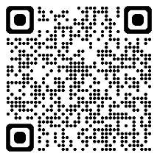
Webinar Support & Resources
Reach out to NCADEMI Program Assistant Natalie Cardenas in the chat if you need technical support
Captions
Slide deck & resources are available at: bit.ly/braille-assess-webinar
Recording will be available within 24-48 business hours on the resources page

Slide 3
Webinar Communication
Use Zoom Chat to respond to presenter prompts, communicate with other attendees, and share resources.
Use the React button to raise your hand and ask clarifying questions as we go. If we have time at the end, we will answer any remaining questions.

Slide 4
Webinar Facilitators
Jena Fahlbush Technical Assistance Specialist, NCADEMI
Jen Govender AT&AEM Specialist, AT&AEM Center at OCALI

Slide 5

Webinar Goals
Raise awareness about the need to provide braille for state assessments.
Promote the availability of the Braille Accessibility in State Assessments guide.
Provide recommendations for how to get started using the guide.

Slide 6
The NCADEMI –OCALI AT&AEM Center Partnership

Slide 7


Our Mission: Improve the Provision of Braille for State Assessment
Notes:
Braille image by OpenIcons from Pixabay free for use under the Pixabay Content License.
Assessment image by Mohamed Hassan free for use under the Pixabay Content License.

Slide 8
Braille Accessibility in State Assessments

Slide 9
Poll #1
How familiar are you with braille accessibility in state assessments?
Very familiar
Somewhat familiar
Heard of it, but not involved
Not familiar at all

Slide 10
Why Braille Accessibility Matters
Students who read braille must have equal access to state assessments.
Lack of access leads to:
Unfair testing conditions
Invalid test results
Violation of legal requirements (IDEA, ADA, Section 504)

Slide 11

Legal and Ethical Foundations
IDEA: Braille instruction must be considered for all students with visual impairments
ADA Title II: Equal access and usability
Section 504: Non-discriminatory access to assessments
Notes:
IDEA:
IDEA 2004, §300.324(a)(2)(iii): "In the case of a child who is blind or visually impaired, the IEP Team must provide for instruction in Braille and the use of Braille unless the team determines, after an evaluation of the child’s reading and writing skills, needs, and appropriate reading and writing media (including an evaluation of the child’s future needs for instruction in Braille or the use of Braille), that instruction in Braille or the use of Braille is not appropriate for the child."
Braille must be the default consideration, not the exception.
If Braille is not provided, the IEP must document why it is not appropriate, based on a comprehensive evaluation.
The decision must consider both current and future needs.
ADA:
ADA Title II Regulations (28 CFR § 35.160):
"A public entity shall take appropriate steps to ensure that communications with applicants, participants... with disabilities are as effective as communications with others."
Braille must be provided when it's necessary for effective communication, when it aligns with their needs.
Section 504 of the Rehabilitation Act:
34 CFR § 104.33 – Requires the provision of a Free Appropriate Public Education (FAPE) to students with disabilities, which includes instructional materials in accessible formats.
A student with a visual impairment must receive materials in formats that allow them to access the curriculum

Slide 12
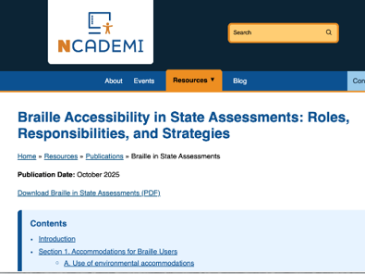
Braille Accessibility in State Assessments: Roles, Responsibilities, and Strategies

Slide 13
About the Guide
Purpose: To initiate conversations and actions that improve the timeliness and quality of braille (embossed and electronic) and tactile graphics for state-mandated assessment.
Target audience: State and local educational agency (SEA and LEA) assessment leaders, Braille assessment support personnel, braille service providers, authorized media producers (AMP), and assessment developers.

Slide 14
Four Key Sections of the Guide
Accommodations for Braille Users
Test Requirements and Components
Administration of Assessments in Braille Format​
Supportive Roles (SEA, LEA, and Assessment Vendors)

Slide 15
Poll #2
Do you oversee or support accessibility/accommodations for state assessments?
Yes
No
Partially/In coordination with another team

Slide 16
Section #1
Accommodations for Braille Users

Slide 17
Accommodations for Braille Users
Environmental supports
Assistive technology (e.g., braille notetakers, screen readers)
Accessible formats (UEB, Nemeth, tactile graphics)
Response methods (oral, braille, digital)

Slide 18
Section #2
Test Requirements and Components

Slide 19
Test Requirements and Components
Review for bias and accessibility
Certified braille transcribers and proofreaders
MathML for digital math content
Post-assessment evaluation practices

Slide 20
Section #3
Administration of
Assessments in
Braille Format

Slide 21
Administration of Assessments in Braille Format
Establish coordination and consistency across SEAs
Provide clear state-level guidance to LEAs
Deliver equivalent practice test opportunities for braille users

Slide 22
Section #4
Supportive Roles (SEA, LEA, and Assessment Vendors)

Slide 23
SEA, LEA, & Assessment Vendors Roles
SEA
Set policy
Guide LEAs
Ensure quality
Coordinate resources
LEA
Identify students
Order materials
Prepare technology
Train staff
Assessment Vendors and AMPs
Production and formatting
Technology compatibility
Quality assurance

Slide 24
Appendices
UEB Math/Science vs. UEB with Nemeth
Best Practices for Image Description
Glossary

Slide 25
Appendix A: UEB Math/Science vs. UEB with Nemeth
Explains differences between two technical braille codes
Offers guidance on selecting appropriate formats based on student needs
Emphasizes using IEP/504 plans to document the correct code

Slide 26
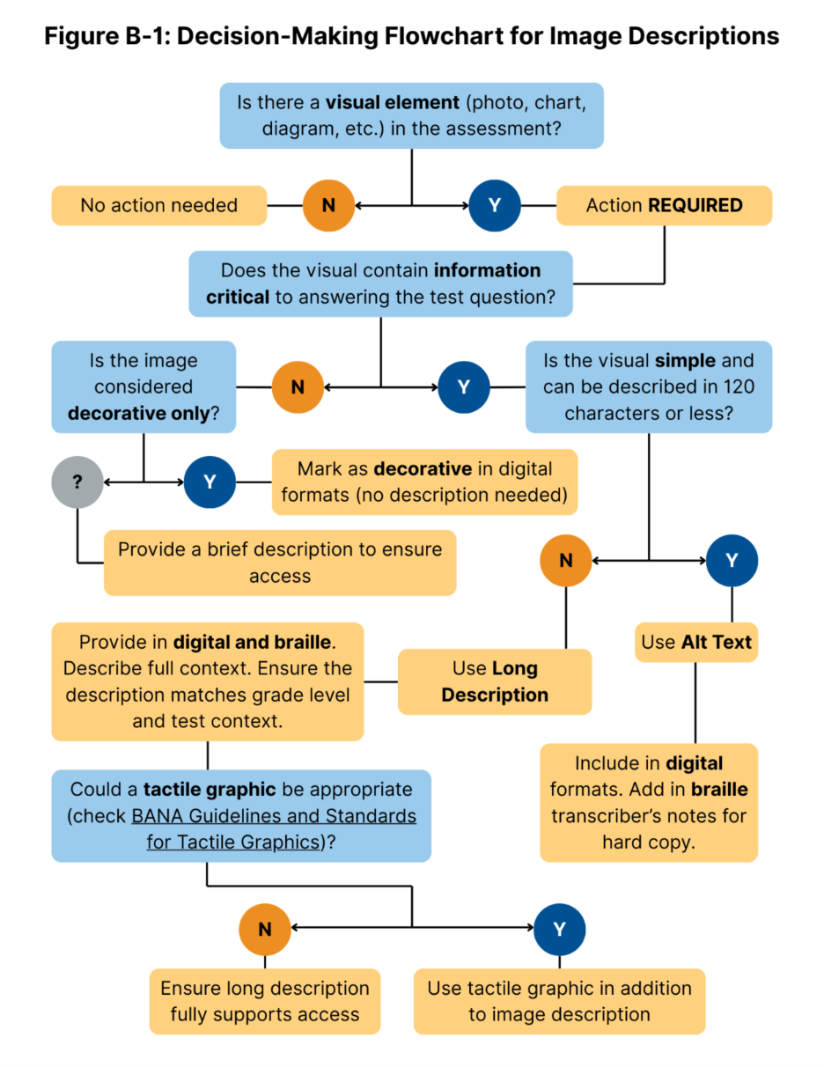
Appendix B: Best Practices for Image Description
Provides a decision-making flowchart for describing visuals
Distinguishes between alt text and long descriptions
Includes links to national guidelines and examples

Slide 27
Getting Started with the Guide
Sharing the guide with IEP teams and assessment personnel
Building cross-agency teams
Conversation starters and email template

Slide 28
Recommendations to Move Forward
Establish roles and responsibilities at SEA and LEA levels
Collaborate with assessment vendors early
Provide professional development on:
Braille formats
Tactile graphics
Assistive Technology integration
Use practice assessments with student's AT devices/tools

Slide 29
Poll #3
Which components of the new guide are you most interested in exploring?
Accommodations for braille users
Administration of assessments in braille format
Test development/production standards
SEA, LEA, and Assessment Vendors and AMPs roles and responsibilities
Appendices

Slide 30
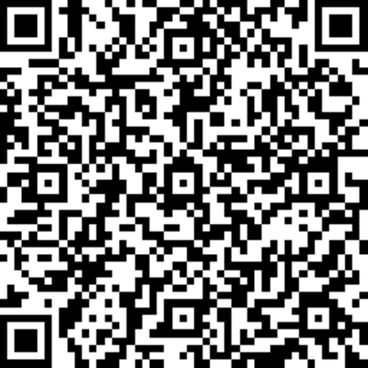
Your Feedback Matters
Please take a moment to complete the survey for this session!

Slide 31
Contact, Connect, & Stay Informed
NCADEMI
OCALI AT&AEM Center
ncademi.org
ncademi@usu.edu
435.554.8213 (voice or text)
NCADEMI on LinkedIn
ataem.org
ataem_info@ocali.org
614.410.1042 (voice)
AT&AEM Center on LinkedIn
@ataem_ocali on Instagram & Twitter

Slide 32




Disclaimers
The contents of this slide deck were developed under a cooperative agreement with the U.S. Department of Education, Office of Special Education Programs, Award No. H327Z240007. However, those contents do not necessarily represent the policy of the Department of Education, and you should not assume endorsement by the Federal Government. Project Officer: Rebecca Sheffield, Ph.D.
The contents of this slide deck are licensed under a Creative Commons Attribution-ShareAlike 4.0 International License (CC BY-SA 4.0).
ncademi.org | ataem.org

Slide 33

Questions?

