Slide 1
Powering Access Through Systemic Action
Webinar 1 of 6: Overview & Foundation
October 9, 2025

Slide 2
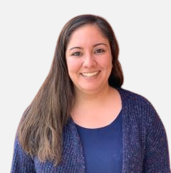
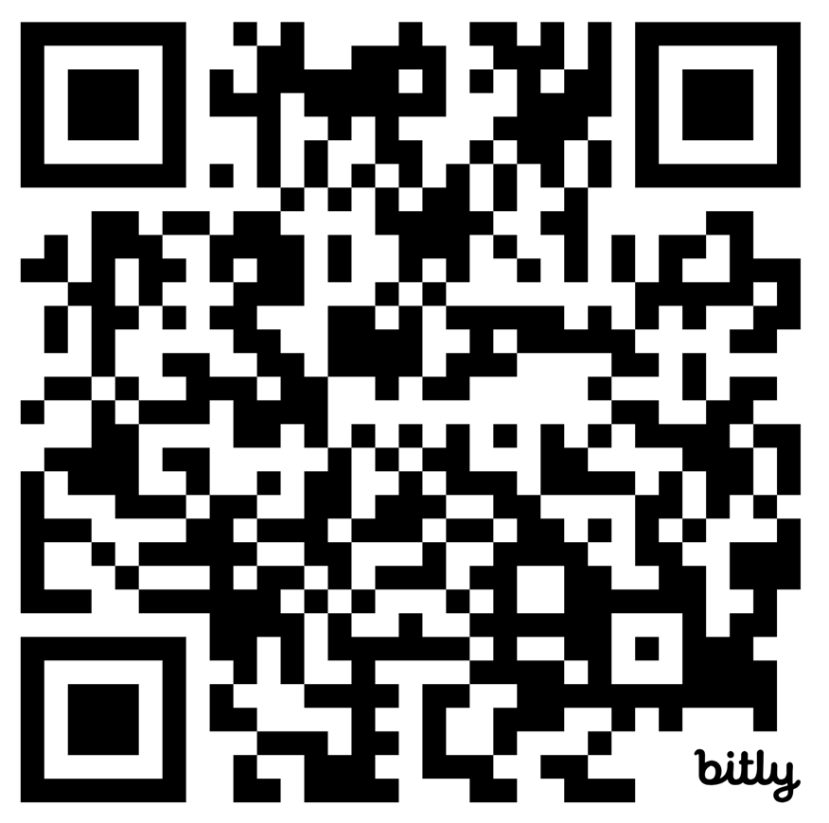
Webinar Support & Resources
Reach out to NCADEMI Program Assistant Natalie Cardenas in the chat if you need technical support
Captioning
Slide deck & resources are available at: bit.ly/qi-webinar1
Recording will be available within 24-48 business hours on the resources page

Slide 3
Webinar Communication
Use Zoom Chat to respond to presenter prompts, communicate with other attendees, and share resources.
Use the React button to raise your hand and ask clarifying questions as we go. If we have time at the end, we will answer any remaining questions. Bring additional questions to next week’s office hours!

Slide 4

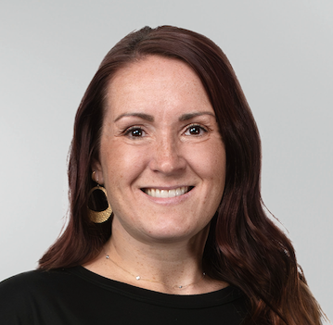
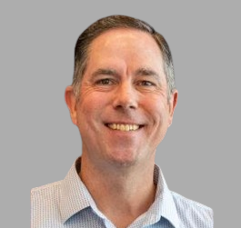

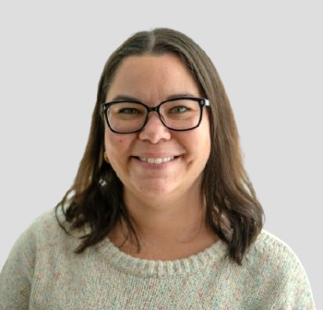
Webinar Series Facilitators
Jena Fahlbush
Technical Assistance Specialist
Rob Carr
Digital Accessibility Specialist
Cynthia Curry
Project Director
Christopher Phillips
Technical Assistance Specialist
Kristen Perez-Rickels
Technical Assistance Specialist

Slide 5
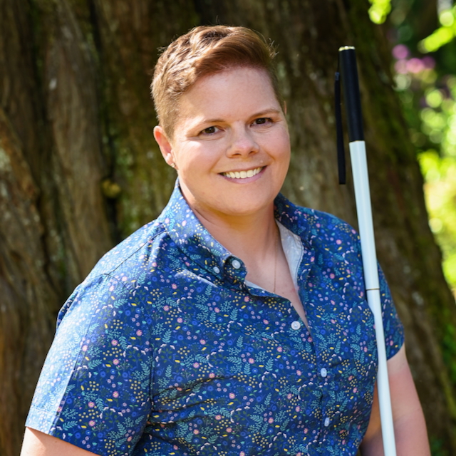
Today's Guest
Dr. Natalie Shaheen, Researcher & Teacher Educator, Illinois State University

Slide 6
About NCADEMI &
This Webinar Series

Slide 7

NCADEMI (“n-cademy”)
A technical assistance (TA) center funded by the U.S. Department of Education's Office of Special Education Programs (OSEP) to improve the quality, availability, and timely provision of accessible digital educational materials and instruction for learners with disabilities from preschool through high school graduation.

Slide 8
2 Tiers of Technical Assistance
Universal TA or UTA
Targeted TA or TTA
“General TA and information provided to independent users through their own initiative, resulting in minimal interaction with TA project staff.”
This webinar series is an example of Universal TA.
“Specialized TA services based on needs common to multiple recipients and not extensively individualized. A relationship is established between the TA recipient and one or more TA project staff.”
This webinar series will prepare participants for Targeted TA.
Notes:
U.S. Department of Education (2024, January 3). Applications for New Awards; Educational Technology, Media, and Materials for Individuals With Disabilities Program—National Center on Digital Access in Education. Federal Register, 89(2). Footnotes 9 and 10.

Slide 9

Series Timeline
Webinar 1: Overview & Foundation
Webinar 2: Intro to Quality Indicators & Readiness
Webinar 3: DM Indicators
Webinar 4: AF Indicators
Webinar 5: Self-Assessment
Webinar 6: TTA Readiness

Slide 10
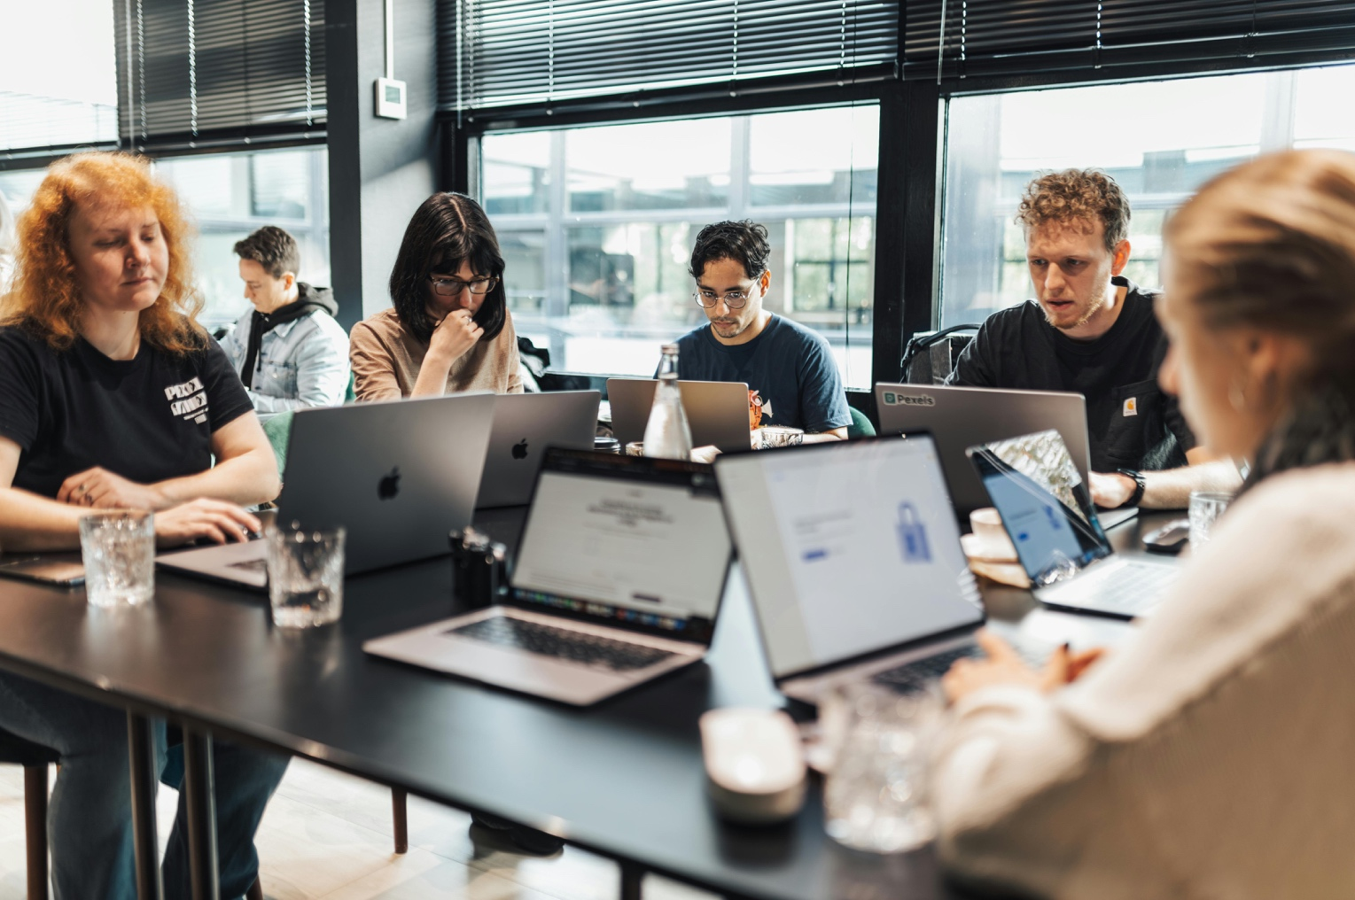
Targeted TA Launches in January 2026
A Professional Learning Group for Digital Accessibility in Education
Virtual meetings of SEAs and LEA teams implementing the Quality Indicators in cycles of Plan-Do-Study-Act
No application and rolling enrollment
Completion of the Readiness Protocol required
Sign up for NCADEMI notifications to stay updated

Slide 11
What is Digital Accessibility?

Slide 12
Frequently Used Interchangeably
“Accessible”
“Available”
“Inclusive”
“Affordable”
“Usable”

Slide 13

“Accessible” in Federal Law & Guidance
An individual with a disability can ​
access the same information,​
engage in the same interactions,​ and ​
otherwise participate in or benefit from the same services, programs, and activities ​
as individuals without disabilities, in a manner that provides substantially equivalent timeliness, privacy, independence, and ease of use.​
Department of Justice, Civil Rights Division & Department of Education, Office for Civil Rights
Notes:
Decorative image by Schwarzenarzisse used under the Pixabay Content License: https://pixabay.com/photos/isolated-auction-dish-paragraphs-2532037/

Slide 14

What Makes Material Accessible?
Timeliness: Materials are available when instruction begins.
Privacy: Students access materials without sharing credentials or relying on others.
Independence: Students can use materials on their own, without intermediaries.
Ease of use: Materials work seamlessly with assistive technology.
Notes:
Jena

Slide 15

Poll
In one word or phrase, how would you describe your system’s current approach to accessibility?
Emerging
Scattered
Siloed
Intentional
Unclear
Embedded

Slide 16
Why Does It Matter?
Notes:
Natalie S

Slide 17
So Much More than Compliance
“You've set the whole class with handouts and stuff to use this website for the next three weeks to compose a project and now me, or [another blind student], is stranded on this desert island because that site doesn't work. You can't just re-change your whole teaching plan, especially when you've distributed it.” ~Jacob

Slide 18
Blind and Low-Vision Teens Explain
Q1: What is it like being a blind/low-vision student in classes that use inaccessible technology?
  A1: It’s like playing the desert island game—a rigged game where you have to discover hidden rules and develop special skills to survive.
Q2: What meaning do blind/low-vision students make of their experiences in classes that use inaccessible technology?
  A2: Access is my responsibility (I can’t count on other people)

Slide 19
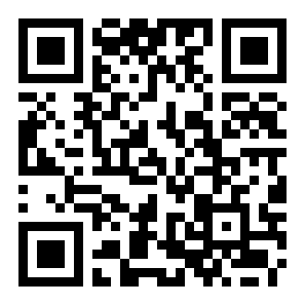
Sometimes I Cry
Rebecca
  18
  Midwestern public high school
  Braille reader
  Screen reader user
  High-achieving student
Meghan
  14
  Rebecca’s sister
  Sighted
Read the story

Slide 20
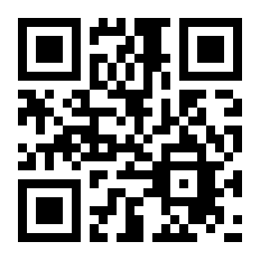
Learn More from Blind & Low-Vision
Students
A11y in Sci library
10 research-based stories
This material is based upon work supported by the National Science Foundation under Award No. 2334693.

Slide 21
Who is Responsible for Ensuring Access?

Slide 22

We’re All in for Accessibility
Notes:
Image source: https://www.pexels.com/photo/photo-of-people-near-wooden-table-3184418/

Slide 23

Get the Accessibility Conversation Started
Connect with one colleague at your school, district, or state to explore an accessibility practice in your setting.
To connect with a colleague, try:
Conversation starters
Sample email template

Slide 24
Looking Ahead

Slide 25
Office Hours
Tuesday, October 14 from 4:00 – 4:50pm ET
Wednesday, October 15 from 6:00 – 6:50pm ET
The link to the office hour registration and session reminders will be sent in tomorrow’s post-webinar notification email.

Slide 26
Webinar 2
Intro to Quality Indicators & Readiness
Date: October 23, 2025
Time: 2:00 – 2:50 p.m. ET

Slide 27
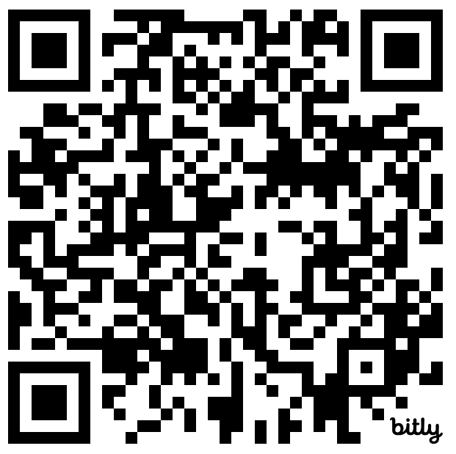
Contact, Connect, and Stay Informed
Contact & Connect
Stay Informed
  ncademi.org
  ncademi@usu.edu
  435.554.8213 (voice or text)
  Follow us on LinkedIn
ncademi.org/newsletter

Slide 28



The Home of NCADEMI
Our project is housed at Utah State University (USU), administered within the Institute for Disability Research, Policy & Practice (IDRPP), in partnership with Web Accessibility in Mind (WebAIM) and Technical Assistance for Excellence in Special Education (TAESE).

Slide 29



Disclaimers
The contents of this slide deck were developed under a cooperative agreement with the U.S. Department of Education, Office of Special Education Programs, Award No. H327Z240007. However, those contents do not necessarily represent the policy of the Department of Education, and you should not assume endorsement by the Federal Government. Project Officer: Rebecca Sheffield, Ph.D.
The contents of this slide deck are licensed under a Creative Commons Attribution-ShareAlike 4.0 International License (CC BY-SA 4.0).
ncademi.org | ncademi@usu.edu

Slide 30
Q&A

