Slide 1
Powering Access Through Systemic Action
Webinar 3 of 6: Quality Indicators for Accessible Digital Educational Materials
November 6, 2025

Slide 2

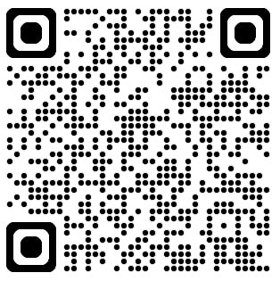
Webinar Support & Resources
Reach out to NCADEMI Program Assistant Natalie Cardenas in the chat if you need technical support
Captions
Slide deck & resources are available at: bit.ly/qi-webinar3
Recording will be available within 24-48 business hours on the resources page

Slide 3
Webinar Communication
Use Zoom Chat to respond to presenter prompts, communicate with other attendees, ask questions, and share resources.
Use the React button to raise your hand and ask clarifying questions as we go. If we have time at the end, we will answer any remaining questions. Bring additional questions to next week’s office hours!

Slide 4
Webinar Series Facilitators
Jena Fahlbush Technical Assistance Specialist
Rob Carr Digital Accessibility Specialist
Cynthia Curry Project Director
Christopher Phillips Technical Assistance Specialist
Kristen Perez-Rickels Technical Assistance Specialist
Notes:
Rob

Slide 5

Today's Guest
Mary Lane
Former Education Consultant, New Hampshire Department of Education

Slide 6

Series Timeline
Webinar 1: Overview & Foundation
Webinar 2: Intro to Quality Indicators & Readiness
Webinar 3: DM Indicators
Webinar 4: AF Indicators
Webinar 5: Self-Assessment
Webinar 6: TTA Readiness

Slide 7
Webinar 2 Takeaways
Notes:
Jena 7-17

Slide 8


Watering the Sprout
Webinar 2 Recording & Resources
IDEA and ADA Title II have requirements for providing accessible materials in PreK-12.
NCADEMI’s evidence-based Quality Indicators are aligned with both laws.
Before implementing the Quality Indicators, make sure your team is prepared by using the Readiness Hexagon Tool.

Slide 9
Webinar 3: Quality Indicators for Accessible Digital Educational Materials
Notes:
Cynthia 10-15

Slide 10
Recall the Two Sets of Quality Indicators
Accessible Digital Materials (DM)
Accessible Formats (AF)

Slide 11
What do we mean by digital accessibility?
Notes:
Cynthia

Slide 12

Equally Effective and Equally Integrated
Timeliness: Materials are available when instruction begins.
Privacy: Students access materials without sharing credentials or relying on others.
Independence: Students can use materials on their own, without intermediaries.
Ease of use: Materials work seamlessly with assistive technology.

Slide 13
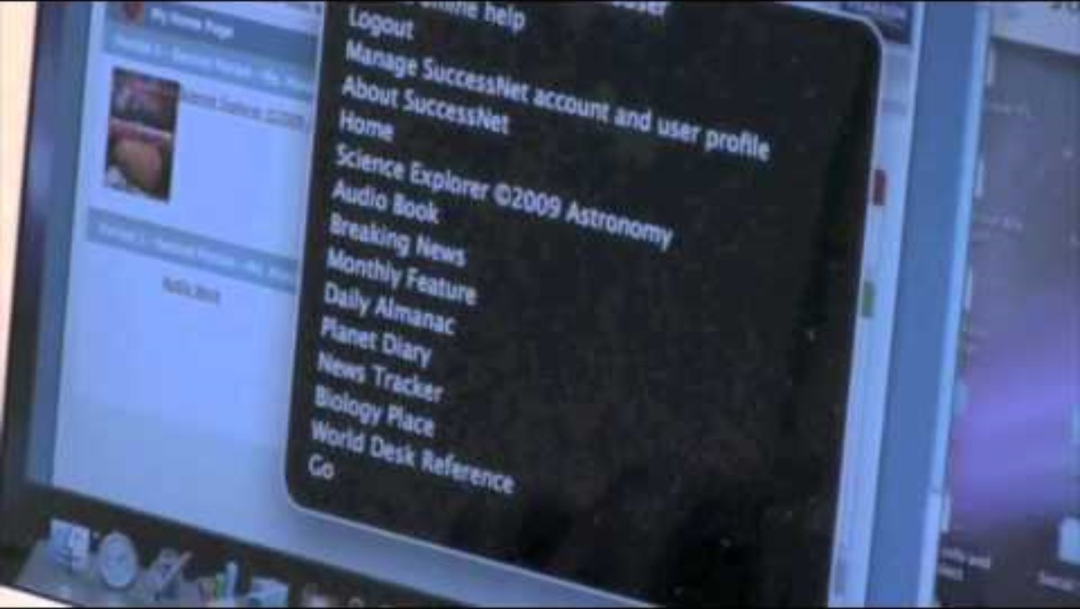
Digital Accessibility in Action in 2008
Notes:
Cynthia

Slide 14
QIs for Accessible Digital Materials (DM)
Offer guidance on providing accessible digital materials through:
Procurement
Educator selection
Educator creation
Incorporate leadership, training, continuous improvement, and sustainability.
Are designed with SEA leadership in mind to minimize duplication of effort by LEAs.
Are directly aligned with the ADA Title II final rule.
Notes:
Cynthia

Slide 15
Americans with Disabilities Act
ADA provides broad protection against discrimination​
Title II of the ADA aims at state and local government​
New rule mandates proactive digital accessibility, including in education
Notes:
Rob

Slide 16
Important Updates
Technical standards​
Web Content Accessibility Guidelines, 2.1, Level AA​
Conformance timeline
Based on census population​
Exceptions​
Not applicable to most digital educational materials used for teaching and learning
Notes:
Rob
NCADEMI is here to ensure students can fully participate.
Come to targeted TA or office hours to get into more detail.

Slide 17

Conformance Deadline
Population at or over 50,000​
April 2026​
Population under 50,000 or special district government
April 2027
Notes:
Rob

Slide 18
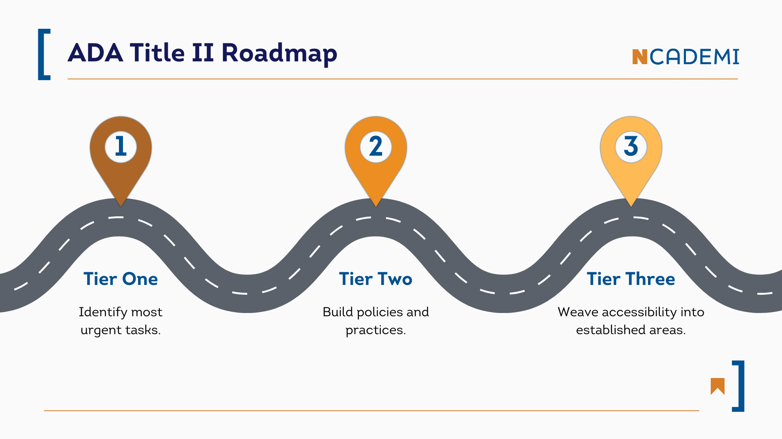
Additional Resource Related to ADA Title II
Roadmap to Conformance for SEAs and LEAs
Notes:
Rob

Slide 19
Getting Started with the Quality Indicators

Slide 20
Interdependent Quality Indicators
Leadership
Guidelines
Training & Support
Continuous Improvement
Sustainability
Notes:
Remind attendees to think about which of the indicators seems the most actionable right now

Slide 21
Quality Indicators for the Provision and Use of Accessible Digital Educational Materials (DM QIs)

Slide 22
Acronyms Defined
“SEA”
“LEA”
State Educational Agency
A state department of education
Partnerships with organizations are common (e.g., AT Act Program, special education technology project)
Local Educational Agency
Typically a school district
Can also refer to an Educational Service Agency (ESA)

Slide 23

DM1: Commitment from Leadership
Essential for initiating and sustaining a coordinated system for providing accessible digital educational materials.
Demonstrated through public messaging, internal structures, and aligning roles and responsibilities.
Established at both the SEA and LEA levels.

Slide 24

New Hampshire’s Leadership Story
How did you determine who should be a part of the leadership team?
How did you initiate the invitations or explain to potential members what the leadership team was about?
What advice do you have for someone who is considering the task of forming a steering committee for their state or district?

Slide 25

DM2: Guidelines for Procurement
Deliberate actions to ensure accessibility is embedded in all components of edtech procurement, including assessments.
SEA leads by modeling the guidelines, which can be adopted or adapted by LEAs.
Resource: Accessibility in Procurement

Slide 26
DM3: Guidelines for Educator-Selected Materials
Clear, actionable guidelines to evaluate the accessibility of digital content selected by educators for classroom use.
The agency considers the roles and responsibilities of staff to distribute the load of implementing these guidelines.
The SEA minimizes duplication of LEA effort by leading the development of these guidelines.

Slide 27

DM4: Guidelines for Educator-Created Materials
Clear, actionable guidelines for creating accessible digital learning materials with agency-supported tools.
The agency considers the roles and responsibilities of staff to distribute the load of implementing these guidelines.
The SEA minimizes duplication of LEA effort by leading the development of these guidelines.
Resource: Accessible Content Creation

Slide 28

DM5: Professional Development and TA
Coordinated, sustainable training and support that builds the capacity of all staff to meet their responsibilities related to digital accessibility.
Training matches specific roles with appropriate tools and techniques.
The SEA coordinates learning opportunities and resources with federally and state-funded partners in support of LEAs.

Slide 29

DM6: Data Collection and Use
Progress toward a coordinated system for providing and using accessible digital educational materials is continuously measured.
Feedback is gathered from multiple sources with strong privacy protections.
Both the SEA and LEAs use data to inform decisions about procurement, training, instructional practice, and student support.

Slide 30

DM7: A Sustainability Plan
Moving from an initiative into a lasting, established program—and keeping it going over time.
Both the SEA and LEAs use self-assessment data in cycles and adopt a continuous improvement mindset.

Slide 31
Poll
Which DM QI are you interested in exploring more deeply? Why?
Commitment from Leadership (DM1)
Educator-Selected Materials (DM3)
Educator-Created Materials (DM4)
Accessible Procurement (DM2)
Training & Support (DM5)
Accessibility Data (DM6)
Sustainability Plan (DM7)

Slide 32
Looking Ahead
Notes:
Christopher

Slide 33

Before Our Next Webinar (11/20)
Work with your team to review and complete the Practice Indicators section of the Hexagon Readiness Tool as a first step in assessing your agency’s readiness to implement one or both sets of Quality Indicators.
No team yet? Find one colleague and dive in together!

Slide 34

Keep Your Accessibility Conversations Going
Ask to add a 2–3 minute “accessibility moment” to a team, department, or leadership meeting.
Conversation Prompt: “I’ve been learning about ADA Title II and IDEA and how accessibility plays out in our systems, especially when it comes to providing accessible materials for students with disabilities. I’d like to share one quick insight and ask how this connects to our current work.”

Slide 35
Office Hours
When
Sample Questions
Tuesday, November 11 from 4:00 – 4:50pm ET
Wednesday, November 12 from 6:00 – 6:50pm ET
The link to the office hour registration and session reminders will be sent in the post-webinar notification email.
How do I get others to value accessibility?
How do the Quality Indicators connect to other initiatives we’re already doing?
How often should our team meet?
Notes:
Christopher

Slide 36
Webinar 4 Accessible Formats (AF) Quality Indicators
Date: November 20, 2025
Time: 2:00 – 2:50 p.m. ET
Notes:
Christopher

Slide 37
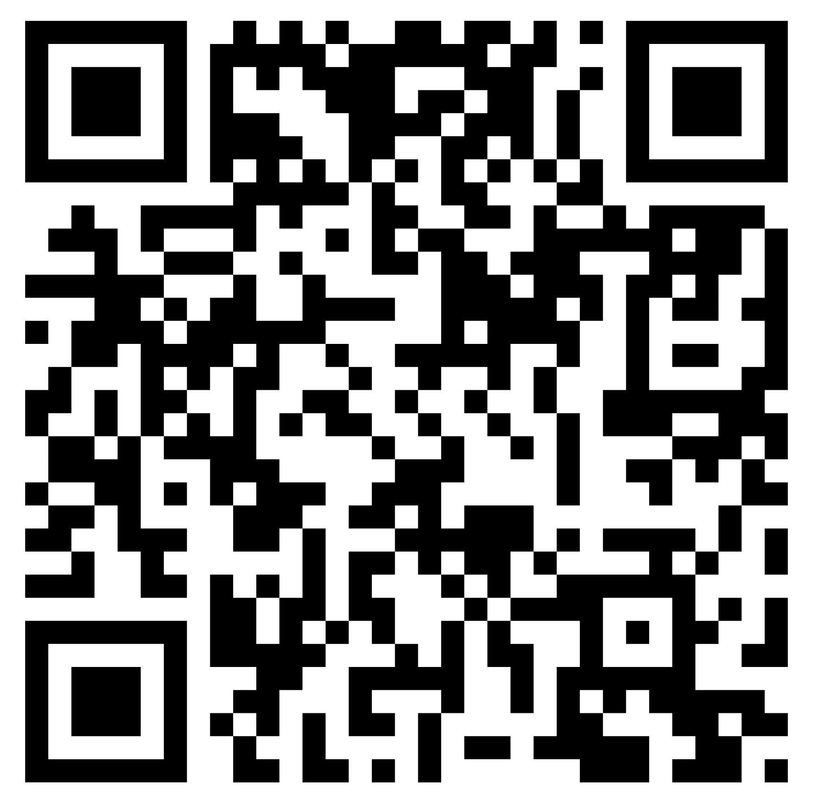
Contact, Connect, and Stay Informed
Contact & Connect
Stay Informed
ncademi.org
ncademi@usu.edu
435.554.8213 (voice or text)
Follow us on LinkedIn
ncademi.org/newsletter

Slide 38



The Home of NCADEMI
Our project is housed at Utah State University (USU), administered within the Institute for Disability Research, Policy & Practice (IDRPP), in partnership with Web Accessibility in Mind (WebAIM) and Technical Assistance for Excellence in Special Education (TAESE).

Slide 39



Disclaimers
The contents of this slide deck were developed under a cooperative agreement with the U.S. Department of Education, Office of Special Education Programs, Award No. H327Z240007. However, those contents do not necessarily represent the policy of the Department of Education, and you should not assume endorsement by the Federal Government. Project Officer: Rebecca Sheffield, Ph.D.
The contents of this slide deck are licensed under a Creative Commons Attribution-ShareAlike 4.0 International License (CC BY-SA 4.0).
ncademi.org | ncademi@usu.edu

Slide 40
Q&A

