Slide 1
Powering Access Through Systemic Action
Webinar 4 of 6: Quality Indicators for Accessible Formats
November 20, 2025

Slide 2
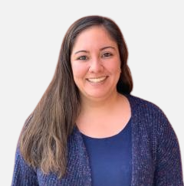
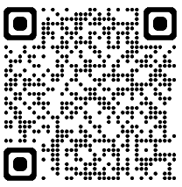
Webinar Support & Resources
Reach out to NCADEMI Program Assistant Natalie Cardenas in the chat if you need technical support
Captions
Slide deck & resources are available at: bit.ly/qi-webinar4
Recording will be available within 24-48 business hours on the resources page

Slide 3
Webinar Communication
Use Zoom Chat to respond to presenter prompts, communicate with other attendees, ask questions, and share resources.
Use the React button to raise your hand and ask clarifying questions as we go. If we have time at the end, we will answer any remaining questions.

Slide 4
Webinar Series Facilitators
Jena Fahlbush
Technical Assistance Specialist
Rob Carr
Digital Accessibility Specialist
Cynthia Curry
Project Director
Christopher Phillips
Technical Assistance Specialist
Kristen Perez-Rickels
Technical Assistance Specialist

Slide 5
Thank you for your feedback!
We used your suggestions to:
Add more information to each webinar's introduction.
Create a resource to support participants with recruiting a team to get started with the Quality Indicators.
Remind you to submit specific questions and TA requests on digital accessibility policies and practices to us by email or phone:
  ncademi@usu.edu
  435.554.8213 (voice or text)

Slide 6

Webinar Series Goals
Prepare state and local education teams to implement the Quality Indicators for the Provision and Use of Accessible Materials in PreK-12 Systems.
Build a foundation for NCADEMI's upcoming targeted technical assistance, launching in January 2026.

Slide 7

Series Timeline
Webinar 1: Overview & Foundation
Webinar 2: Intro to Quality Indicators & Readiness
Webinar 3: DM Indicators
Webinar 4: AF Indicators
Webinar 5: Self-Assessment
Webinar 6: TTA Readiness

Slide 8
Poll #1
How many webinars in this series have you attended/watched the recording?
This is my first webinar.
1
2
All of them to date.

Slide 9
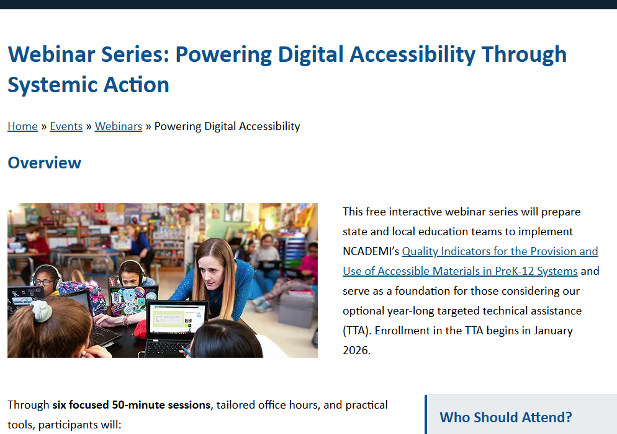
Webinar Series & Resource Pages
Scroll down to find:
Links to all the webinar resource pages
YouTube Playlist of all the recordings

Slide 10
Webinar 3 Takeaways

Slide 11

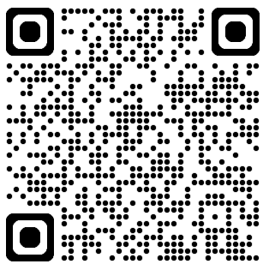
Watering New Growth
Webinar 3
Recording & Resources
Digital accessibility: Equally effective
and equally integrated – with
substantially equivalent ease of use.
ADA Title II update requires digital accessibility of educational materials and technology used in schools.
The QIs for Accessible Digital Educational Materials help state and local teams
create and sustain digital accessibility.

Slide 12
Webinar 4: Quality Indicators for Accessible Formats

Slide 13
What do we mean by accessible formats?

Slide 14
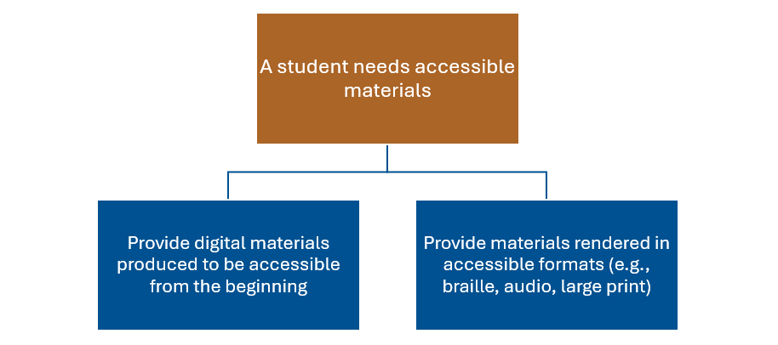
Recall the Two Pathways to Provide Accessible Materials

Slide 15
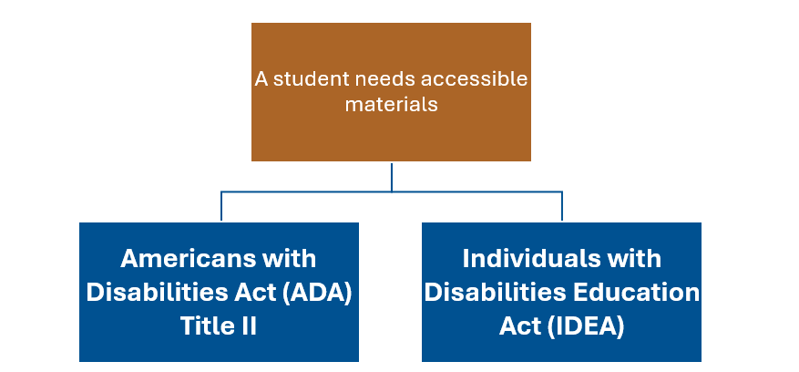
Two Pathways to Provide Accessible Materials & Related Laws

Slide 16
Examples of Accessible Formats
Print or Digital Text
Audio
Braille
Accessible digital text
Large print
Audio
Tactile graphics of images
Text transcript
Video
Captioned video
Audio described video
Video with synchronized American Sign Language (ASL)

Slide 17
IDEA and Accessible Formats
Individuals with Disabilities Education Act (IDEA)
  Makes available a free appropriate public education to students with disabilities.
  Requires SEAs and LEAs to provide accessible formats when needed.
  To support this requirement, established the National Instructional Materials Accessibility Standard (NIMAS) and the National Instructional Materials Access Center (NIMAC).

Slide 18
NIMAS & NIMAC
NIMAS
NIMAC
A technical standard used by publishers
Standardizes the process for converting materials to accessible formats
An online repository of NIMAS files ready to be converted to accessible formats
Accessed by Authorized Users who facilitate the production of accessible formats

Slide 19

Resources for Understanding NIMAS-NIMAC
Guide - NIMAS & NIMAC: What SEAs & LEAs Need to Know
Recorded webinar – Coordinating with the NIMAC: What It Means and Why It's So Important

Slide 20
Acquiring Accessible Formats
Accessible Media Producers
  Convert NIMAS files to accessible formats
  Produce accessible formats from other source files and media types
  Examples: Bookshare, American Printing House for the Blind (APH), Described & Captioned Media Program (DCMP)
National Library Service and network of state libraries
Local conversion

Slide 21
Accessible Formats in the IEP
An IEP team decision-making process:
Determine a student’s
need
Select the appropriate format
Identify the source of the format needed
Support for the use of accessible formats
Resources:
More to the Myths and Facts: Addressing Accessible Educational Materials in the 2024 Assistive Technology Guidance
Addressing AEM in the IEP: SEA Examples
National AEM Center: AEM in the IEP

Slide 22
Getting Started with the Quality Indicators

Slide 23
Interdependent Quality Indicators
Leadership
Guidelines
Training & Support
Continuous Improvement
Sustainability

Slide 24
Acronyms Defined
“SEA”
“LEA”
State Educational Agency
  A state department of education
  Partnerships with organizations are common (e.g., AT Act Program, special education technology project)
Local Educational Agency
  Typically a school district
  Can also refer to an Educational Service Agency (ESA)

Slide 25
Quality Indicators for the Provision and Use of Accessible Formats (AF QIs)

Slide 26

AF1: Commitment from Leadership
Essential for initiating and sustaining a coordinated system for providing formats.
Demonstrated through public messaging, internal structures, and aligning roles and responsibilities.
Established at both the SEA and LEA levels.
Resource: Steering Committee Email Template & Tracking

Slide 27

AF2: Guidelines for NIMAC Coordination
Deliberate actions to leverage NIMAS and the NIMAC to provide accessible formats in a timely manner.
SEA leads by modeling the guidelines, which can be adopted by LEAs.
Resources: What SEAs & LEAs Need to Know and Coordinating with the NIMAC

Slide 28

AF3: Guidelines for Accessible Formats in the IEP
Clear, actionable guidelines to guide the IEP team through a process of consideration and documentation.
The SEA minimizes duplication of LEA effort by leading the development of these guidelines.
Resources: More to the Myths & Facts,
SEA Examples, AEM in the IEP

Slide 29

AF4: Guidelines for Acquiring Accessible Formats
Clear, actionable guidelines for initiating the search process, identifying appropriate sources, and protecting copyright.
The SEA minimizes duplication of LEA effort by leading the development of these guidelines.

Slide 30

AF5: Professional Development and TA
Coordinated, sustainable training and support that builds the capacity of all staff to meet their responsibilities related to accessible formats.
Training matches specific roles with appropriate knowledge and resources.
The SEA coordinates learning opportunities and resources with federally and state-funded partners in support of LEAs.

Slide 31

AF6: Data Collection and Use
Progress toward a coordinated system for providing and using accessible formats is continuously measured.
Feedback is gathered from multiple sources with strong privacy protections.
Both the SEA and LEAs use data to improve practice, program planning, and resource allocation.

Slide 32

AF7: A Sustainability Plan
Moving from an initiative into a lasting, established program—and keeping it going over time.
Both the SEA and LEAs use self-assessment data in cycles and adopt a continuous improvement mindset.

Slide 33
Poll #2
Which AF QI are you interested in exploring more deeply? Why?
Commitment from Leadership (AF1)
Accessible Formats in the IEP
(AF3)
Acquiring Accessible Formats (AF4)
NIMAC Coordination (AF2)
Training & Support (AF5)
Accessibility Data (AF6)
Sustainability Plan (AF7)

Slide 34
Looking Ahead

Slide 35


Before Our Next Webinar (12/4)
Work with your team to review and complete the Agency Indicators section of the Hexagon Readiness Tool as the next step in assessing your agency’s readiness to implement one or both sets of Quality Indicators.​
No team yet? Find one colleague and dive in together!​

Slide 36

Keep Your Accessibility Conversations Going
Have an IEP meeting coming up?
Preview the student's current IEP and consider the student's need for accessible formats:
Would the student potentially benefit from accessible formats?
Are accessible formats already included in the IEP?
Share resources from today's webinar with the IEP team.

Slide 37
No Office Hours Next Week
Office Hours Resume in December

Slide 38
Webinar 5
Introduction to the Self-Assessment Tools
Date: December 4, 2025
Time: 2:00 – 2:50 p.m. ET

Slide 39

Targeted TA Launches in January 2026
A Professional Learning Group for Digital Accessibility in Education
Virtual meetings of SEAs and LEA teams implementing the Quality Indicators in cycles of Plan-Do-Study-Act
No application and rolling enrollment
Completion of the Hexagon Tool Readiness Protocol required
Sign up for NCADEMI notifications to stay updated

Slide 40
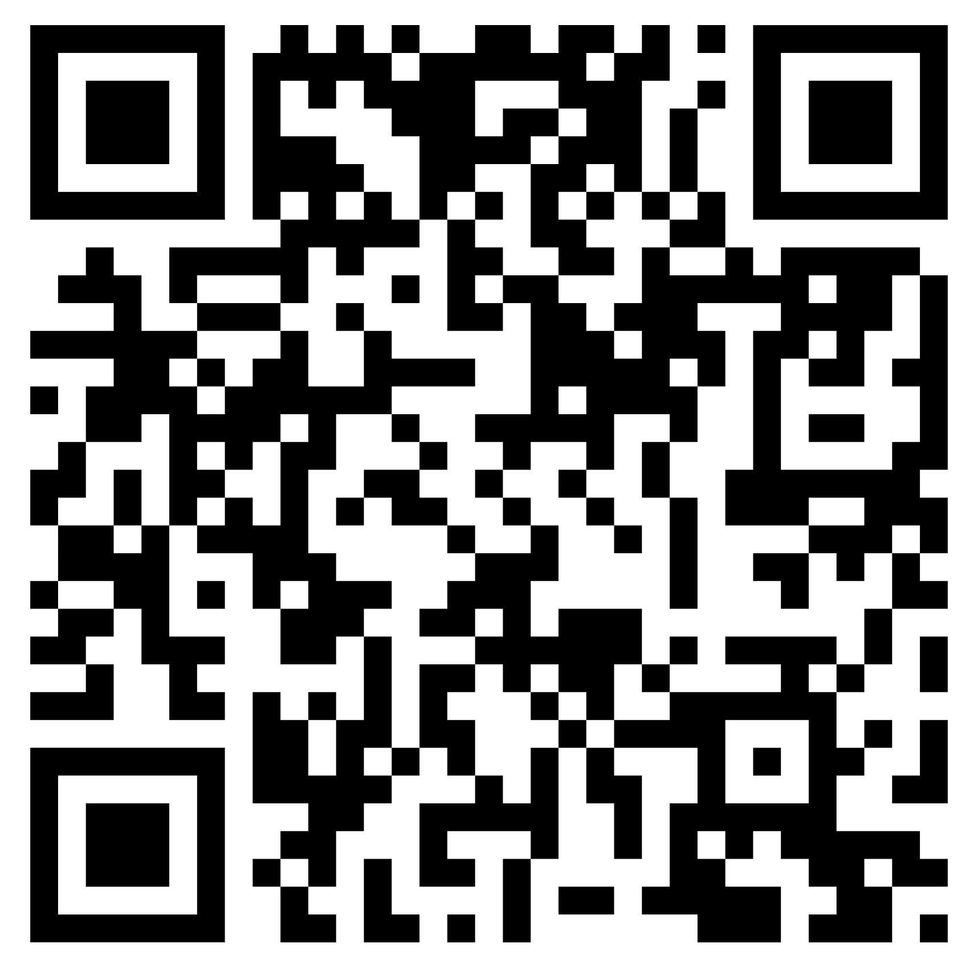
Contact, Connect, and Stay Informed
Contact & Connect
Stay Informed
  ncademi.org
  ncademi@usu.edu
  435.554.8213 (voice or text)
  Follow us on LinkedIn
ncademi.org/newsletter

Slide 41



The Home of NCADEMI
Our project is housed at Utah State University (USU), administered within the Institute for Disability Research, Policy & Practice (IDRPP), in partnership with Web Accessibility in Mind (WebAIM) and Technical Assistance for Excellence in Special Education (TAESE).

Slide 42



Disclaimers
The contents of this slide deck were developed under a cooperative agreement with the U.S. Department of Education, Office of Special Education Programs, Award No. H327Z240007. However, those contents do not necessarily represent the policy of the Department of Education, and you should not assume endorsement by the Federal Government. Project Officer: Rebecca Sheffield, Ph.D.
The contents of this slide deck are licensed under a Creative Commons Attribution-ShareAlike 4.0 International License (CC BY-SA 4.0).
ncademi.org | ncademi@usu.edu

Slide 43
Q&A

