Slide 1
Welcome! The webinar will begin promptly at 2pm ET
Feel free to introduce yourself (or your team) in the chat while we wait, such as:
Your role
Your location
The reason you chose to register for this webinar series

Slide 2
Powering Access Through Systemic Action
Webinar 5 of 6: Using the Self-Assessment Tools for System Improvement
December 4, 2025

Slide 3

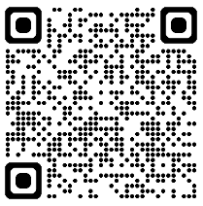
Webinar Support & Resources
Reach out to NCADEMI Program Assistant Natalie Cardenas in the chat if you need technical support
Captions
Slide deck & resources are available at: bit.ly/qi-webinar5
Recording will be available within 24-48 business hours on the resources page

Slide 4
Webinar Communication
Use Zoom Chat to respond to presenter prompts, communicate with other attendees, ask questions, and share resources.
Use the React button to raise your hand and ask clarifying questions as we go. If we have time at the end, we will answer any remaining questions. Bring additional questions to next week’s office hours!

Slide 5
Webinar Series Facilitators
Jena Fahlbush
Technical Assistance Specialist
Rob Carr
Digital Accessibility Specialist
Cynthia Curry
Project Director
Christopher Phillips
Technical Assistance Specialist
Kristen Perez-Rickels
Technical Assistance Specialist

Slide 6

Webinar Series Goals
Prepare state and local education teams to implement the Quality Indicators for the Provision and Use of Accessible Materials in PreK-12 Systems.
Build a foundation for NCADEMI's upcoming targeted technical assistance, launching in January 2026.

Slide 7

Series Timeline
Webinar 1: Overview & Foundation
Webinar 2: Intro to Quality Indicators & Readiness
Webinar 3: DM Indicators
Webinar 4: AF Indicators
Webinar 5: Self-Assessment
Webinar 6: TTA Readiness

Slide 8
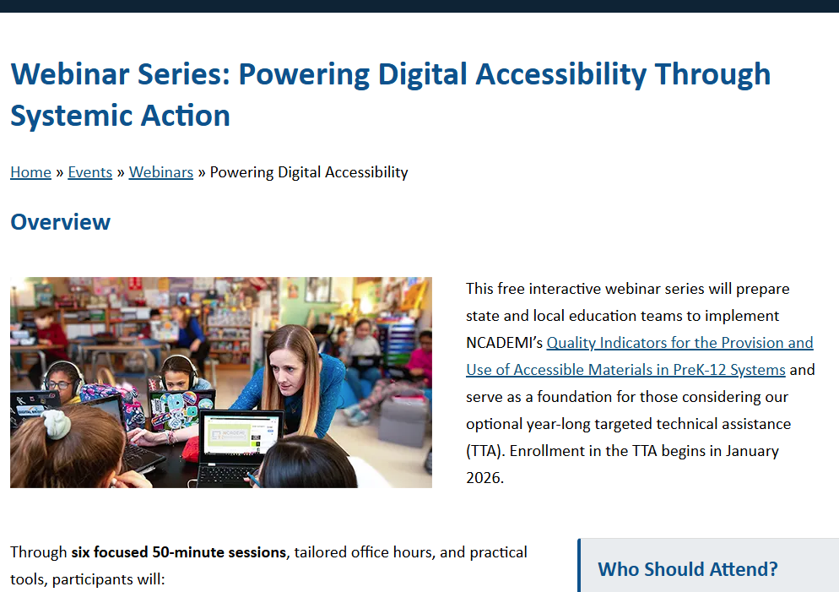
Webinar Series & Resource Pages
Scroll down to find:
Links to all the webinar resource pages
YouTube Playlist of all the recordings

Slide 9
Webinar 4 Takeaways

Slide 10


Watering the Flower
Webinar 4
Recording & Resources
IDEA makes available a free
appropriate public education that
includes the provision of accessible formats when needed.
Accessible formats, including digital text, tactile graphics, transcripts, captions, etc., can be acquired from no-cost sources.
The QIs for Accessible Formats help state and local teams acquire and provide high-quality accessible formats in a timely manner.

Slide 11
Webinar 5: Introduction to the Self-Assessment Tools

Slide 12

Why Conduct Self-Assessments?
Identify strengths, weaknesses, and gaps in your system.
Establish a baseline level of implementation for your agency.
Institute successful implementation through cycles of continuous improvement.

Slide 13
About the Quality Indicator Self-Assessments
Two sets:
  One aligned with the QIs for Digital Materials (DM)
  One aligned with the QIs for Accessible Formats (AF)
Modeled on the concept of Innovation Configurations developed by the CEEDAR Center to "chart a measured course toward change"
Organized around two dimensions:
  Critical Components
  Degree of implementation on a continuum from "Not Started" to "Scaling & Sustaining"

Slide 14
Assumptions
A shared agreement within your agency (SEA, LEA, school) that
  The Quality Indicators are backed by sufficient evidence, usability, and supports
  Implementation of the Quality Indicators
    Addresses a need of your agency
    Aligns with your agency's values, initiatives, priorities, etc. (fit)
    Is within your agency's capacity
Refer to the Readiness Protocol (Hexagon Tool)

Slide 15
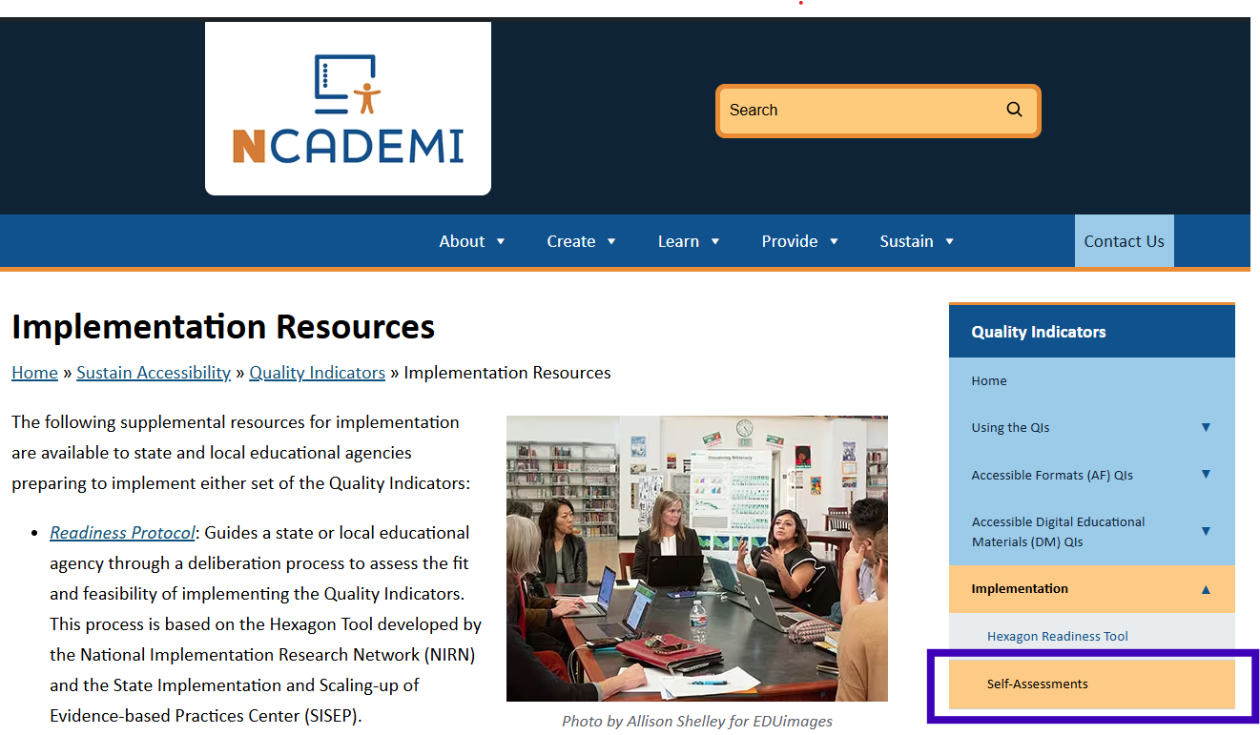
Where to Find the Self-Assessment Tools

Slide 16
Overview: Self-Assessment Process
Gather a team with critical perspectives to conduct the
self-assessment.
Go through each Critical Component Matrix for a Quality Indicator and rate your agency.
  Record rationales.
  Record action items and timelines.
  Record date of next assessment.

Slide 17
DM1.1 Steering Committee
At a minimum, the following roles and responsibilities are included:
Administration from both general and special education
Technology (education, information, instruction, and assistive)
Instructional materials adoption
Curriculum and instruction
Assessment
General education
Special education and related services
Procurement
Finance
Students, staff, parents and caregivers, and community members with and without disabilities
A cross-disciplinary digital accessibility steering committee at both the SEA and LEA levels, determined by the size and organizational structure of the agency.

Slide 18
Critical Component DM1.1 Matrix
Not Started (0) | Emerging (1) | Operationalizing (2) | Scaling & Sustaining (3)
The need for a cross-disciplinary digital accessibility steering committee has not yet been considered. | The SEA and LEAs (the “agency”) are mapping roles, departments, and community participants, with attention to including representatives from each listed area and individuals with disabilities. Initial outreach is underway to invite members. | A steering committee has been established with participants from several key areas of the agency. The committee meets periodically and has begun identifying priorities, building shared understanding of digital accessibility, and coordinating across divisions. Some perspectives may still be underrepresented. | A fully functioning, cross-disciplinary steering committee has been established by the agency. All required roles are represented, including students, parents, and individuals with disabilities. The committee has clearly defined responsibilities, a regular meeting structure, and decision-making or advisory authority. It coordinates with agency leadership and across initiatives. Data, policies, and progress toward accessibility goals are regularly reviewed.

Slide 19
Sample Scenario
A local school district has started paying more attention to how digital accessibility decisions are made across the agency.
District leaders are figuring out which departments and community partners should be involved and recognize the importance of including individuals with disabilities in these decisions. Their early, exploratory conversations focus on understanding current challenges rather than making formal decisions and have included staff from general and special education, curriculum, and technology.
At the same time, a small informal group of educators have been meeting regularly on their own to talk through accessibility issues with digital materials and how departments can work together. This group isn’t fully aware of leadership’s intentions or next steps, and several critical perspectives are missing.

Slide 20
Sample Scenario = Emerging
Emerging (1)
The SEA and LEAs (the “agency”) are mapping roles, departments, and community participants, with attention to including representatives from each listed area and individuals with disabilities. Initial outreach is underway to invite members.
District leaders recognize the need for a cross-department approach to digital accessibility, including community partners.
Early discussions include general ed, special ed, curriculum, and technology, with awareness that more roles and individuals with disabilities still need to be included.
A small, informal group of staff has started addressing digital accessibility issues, showing staff who care and can move this work forward. However, the lack of leadership and key roles limits their scope and impact.
This district is identifying participants and beginning outreach but has not yet formalized a steering committee.

Slide 21

DM5.1: Professional Development Includes Digital Accessibility
Digital accessibility is appropriately integrated into all relevant professional development (PD) priorities, including the use of high-quality instructional materials and edtech in subjects across the curriculum.

Slide 22
Critical Component DM5.1 Matrix
Not Started (0) | Emerging (1) | Operationalizing (2) | Scaling & Sustaining (3)
The need to integrate digital accessibility into PD priorities has not yet been considered or is limited to special education. | The SEA and LEAs (“the agency”) are reviewing current PD priorities and identifying where digital accessibility naturally aligns (e.g., curriculum adoption, instructional design, edtech integration). Planning is underway to embed accessibility principles into these existing initiatives. Coordination between curriculum, tech, and special education leaders is underway. | The agency integrates accessibility concepts into some existing PD offerings (e.g., accessible design during curriculum training, guidance on evaluating edtech tools). PD facilitators begin referencing accessibility as a standard part of instructional quality. Educators are introduced to connections between accessibility and effective teaching practices. | Digital accessibility is a consistent, intentional component of all relevant PD priorities—especially those focused on instructional materials, curriculum planning, and technology use. It is not treated as a separate topic but as fundamental to instructional effectiveness and quality. PD facilitators are trained to model accessible practices, and accessibility is part of evaluation and follow-up support.

Slide 23
Poll
What is your agency's current stage of implementation for DM5.1?
Not Started
Emerging
Operationalizing
Scaling & Sustaining

Slide 24
Documenting the Discussion
Implementation rating of DM5.1:
Team members:
Date of discussion:
Rationale for your rating:
Action items with timelines to make progress:
Date of next assessment:

Slide 25
Rationale for Rating
Why did you select the stage or score you did?
What needs to be in place for it to move up a stage?
Are all of the components in the current stage strong and well-tended?
What other critical components are related to this stage? Does work need to occur in those components before you can make progress in this one?
What vision or ideas do team members have to move this component forward?

Slide 26
Action Items and Timeline
Action Item | Personnel Responsible | Timeline
Proposed action 1 |  | By 1/12/26
Proposed action 2 |  | Within 4 weeks of action 1
Proposed action 3 |  | Between 1/12/26 and 4/30/26
In rationale, you discussed what needs to occur for the agency to move this component up a stage. What needs to be done to enable those activities? Could we engage in that next step already?
What is a reasonable timeline for these steps to occur?

Slide 27
Looking Ahead

Slide 28
Before The Last Webinar (12/18)
Establish your cross-disciplinary steering committee (refer to Quality Indicator 1; Steering Committee Email Template & Tracking).
Complete the Hexagon Tool: Readiness Protocol.
Review prerequisites for enrolling in NCADEMI’s Targeted Technical Assistance for state and local educational agencies that begins in January 2026!

Slide 29

Accessibility Conversations
Have you started an accessibility conversation?
If not, connect with one colleague at your school, district, or state to explore an accessibility practice in your setting. Conversation Starters & Email Template
If you have, now is a great time to circle back to examine how students are impacted by the accessibility practice or lack thereof.

Slide 30
Final Office Hours
When
Sample Questions
Tuesday, December 9 from
4:00 – 4:50pm ET
Wednesday, December 10 from
6:00 – 6:50pm ET
The link to the office hour registration and session reminders will be sent in the post-webinar notification email.
Who should be included on our steering committee?
How long should we wait before scheduling our next self-assessment?
What do we do if our implementation is splintered within one Quality Indicator?

Slide 31
Webinar 6
Targeted Technical Assistance (TA) Readiness
Date: December 18, 2025
Time: 2:00 – 2:50 p.m. ET

Slide 32

New on Our Website: TA Page for SEAs & LEAs
You'll find:
A new report on the results of NCADEMI's 2025 National Digital Accessibility Needs Assessment.
Details about our targeted TA launching in January.
  Enrollment process to be added next week.
  Come to Webinar 6 (or be sure to catch the recording)!

Slide 33
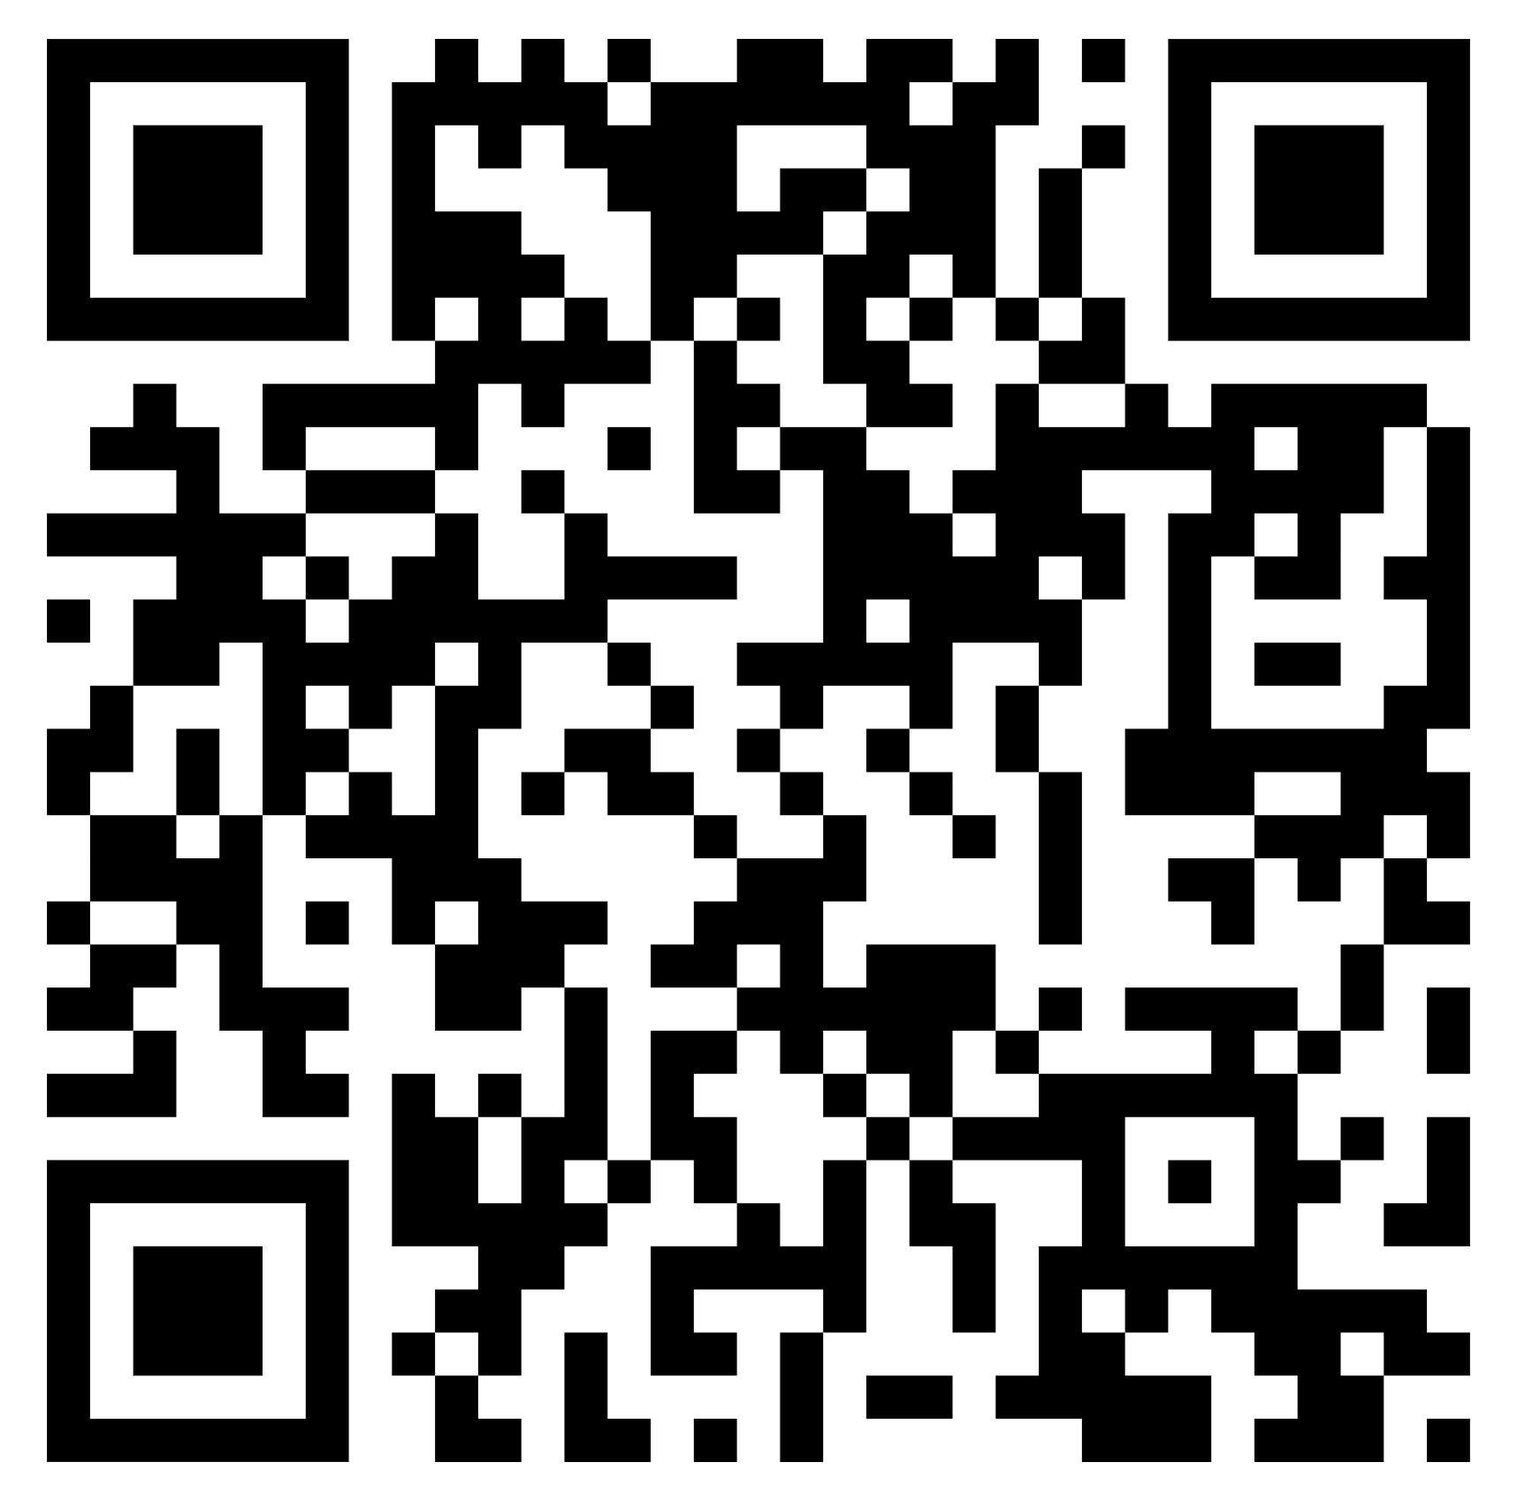
Contact, Connect, and Stay Informed
Contact & Connect
Stay Informed
  ncademi.org
  ncademi@usu.edu
  435.554.8213 (voice or text)
  Follow us on LinkedIn
ncademi.org/newsletter

Slide 34



The Home of NCADEMI
Our project is housed at Utah State University (USU), administered within the Institute for Disability Research, Policy & Practice (IDRPP), in partnership with Web Accessibility in Mind (WebAIM) and Technical Assistance for Excellence in Special Education (TAESE).

Slide 35



Disclaimers
The contents of this slide deck were developed under a cooperative agreement with the U.S. Department of Education, Office of Special Education Programs, Award No. H327Z240007. However, those contents do not necessarily represent the policy of the Department of Education, and you should not assume endorsement by the Federal Government. Project Officer: Rebecca Sheffield, Ph.D.
The contents of this slide deck are licensed under a Creative Commons Attribution-ShareAlike 4.0 International License (CC BY-SA 4.0).
ncademi.org | ncademi@usu.edu

Slide 36
Q&A

