Slide 1
Accessibility in Action –
Practices that Empower Assistive Technology
National Center on Accessible Educational Materials & Instruction (NCADEMI)

Slide 2
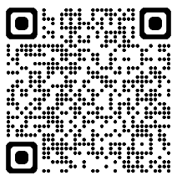
Access Presentation Materials
bit.ly/atia-26-action

Slide 3
ACVREP CEU Session Start Code
If you do not plan to claim ACVREP CEUs (primarily for Vision Impairment Specialists), you do not need to note these codes.
  Start Code:
This session has been approved for ACVREP CEUs. If you plan to claim ACVREP CEUs, please note this code, and the end code that will be shown at the end of this session.
Please visit atia.org/ceus-in-person for full information on how to claim CEUs.

Slide 4
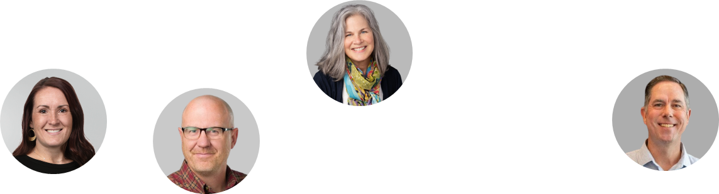
Welcome!
Christopher Phillips, Technical Assistance Specialist
Jena Fahlbush, Technical Assistance Specialist

Slide 5
Speaker Disclosure
Christopher Phillips is an employee of Utah State University and works on a project federally funded by the U.S. Department of Education.
Jena Fahlbush is an employee of Utah State University and works on a project federally funded by the U.S. Department of Education.

Slide 6
Who’s Joining Us Today?

Slide 7

NCADEMI (“n-cademy”)​
A technical assistance (TA) center funded by the U.S. Department of Education's Office of Special Education Programs (OSEP) to improve the quality, availability, and timely provision of accessible digital educational materials and instruction for learners with disabilities from preschool through high school graduation. ​

Slide 8



The Home of NCADEMI​
Our project is housed at Utah State University (USU), administered within the Institute for Disability Research, Policy & Practice (IDRPP), in partnership with Web Accessibility in Mind (WebAIM) and Technical Assistance for Excellence in Special Education (TAESE).​

Slide 9
Learning Objectives
Identify at least three foundational digital accessibility practices that enhance compatibility with assistive technology.
Describe at least two ways assistive technology users are impacted by inaccessible materials.
Apply at least two practical strategies to improve digital content accessibility using tools and approaches introduced in the session.

Slide 10
What are the most common types of assistive technology (AT) that your students use?

Slide 11
AT Supports Access
Contrast modes
Eye gaze
Highlighters
Magnification/Zoom
Note-takers
Screen readers
Switch control
Text-to-speech
Voice control

Slide 12
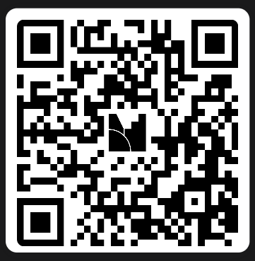
True or False?
Go to menti.com or scan the QR code
Enter code: 6849 1232

Slide 13
“Accessible” in Federal Law & Guidance​
An individual with a disability can ​ ​
access the same information,​​
engage in the same interactions,​ and ​​
otherwise participate in or benefit from the same services, programs, and activities ​​
as individuals without disabilities, in a manner that provides substantially equivalent timeliness, privacy, independence, and ease of use.​
Department of Justice, Civil Rights Division &
Department of Education, Office for Civil Rights​

Slide 14
What is Digital Accessibility?
Teacher materials, videos and web content that works for students with disabilities.

Slide 15

What Makes Material Accessible?​
Timeliness: Materials are available when instruction begins.​
Privacy: Students access materials without sharing credentials or relying on others.​
Independence: Students can use materials on their own, without intermediaries.​
Ease of use: Materials work seamlessly with assistive technology.​

Slide 16
Relationship Between Digital Accessibility and Assistive Technology
As digital accessibility improves,
The need for assistive technology goes down

Slide 17
AT can help with content that is not accessible...
But there are limitations to how much it can help.

Slide 18
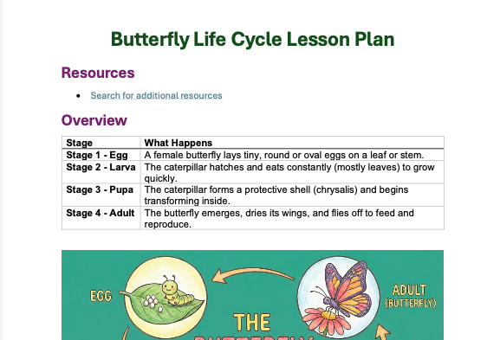
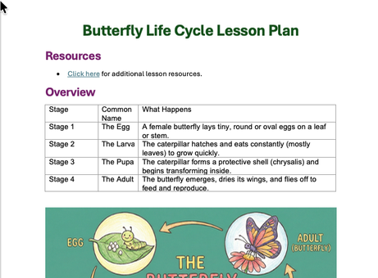
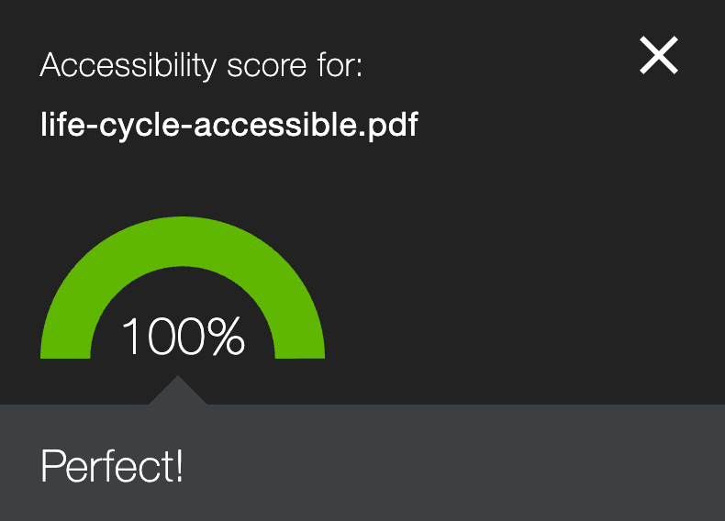
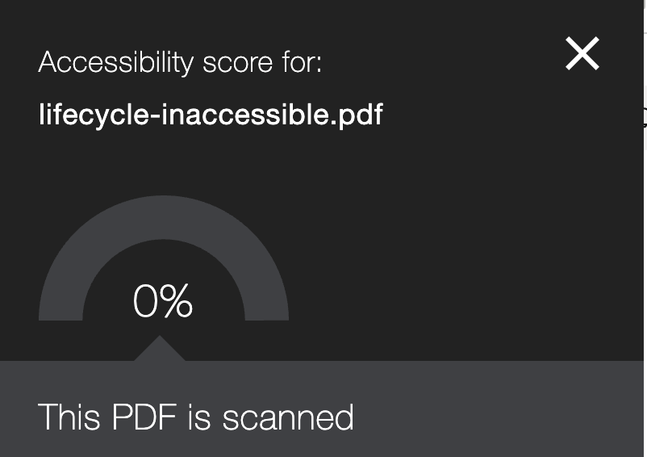
Accessible vs Inaccessible PDF

Slide 19
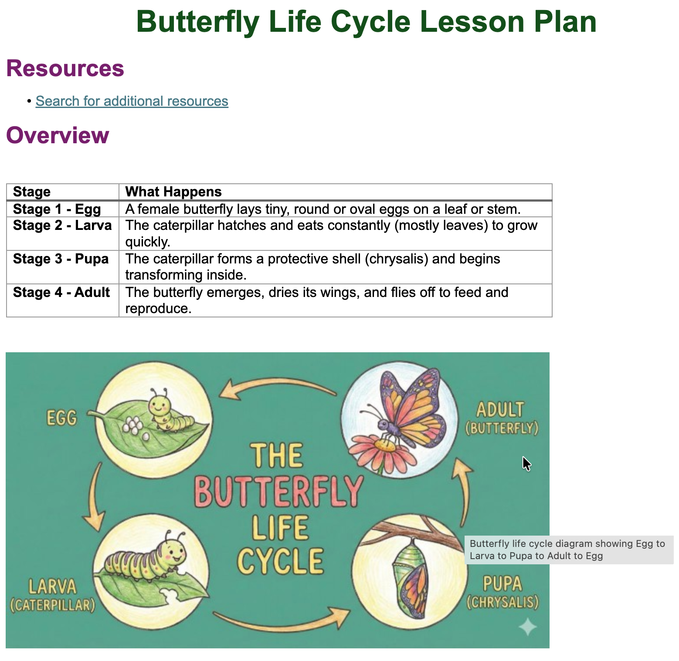
Accessible PDF Content

Slide 20
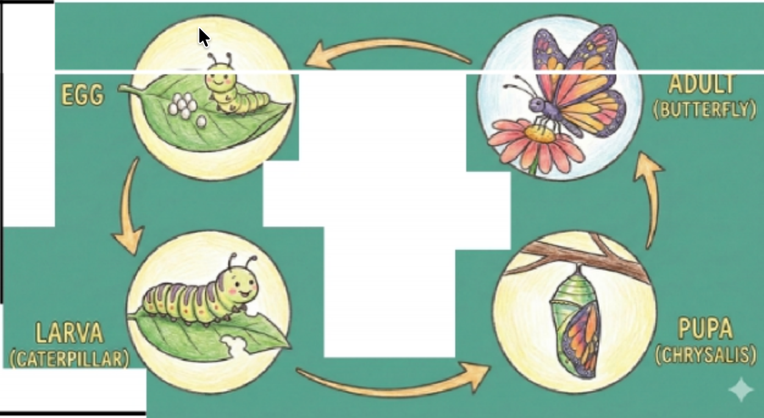

Inaccessible PDF Content
The caterpillar hatches and eats constantly (mostly
leaves) to Qrow auicklv.

Slide 21
The Ripple Effect
Lost instructional time
Student frustration and discouragement
Incomplete assignments
Challenging behaviors
Extra work to retrofit for accessibility

Slide 22
Why This is All Too Common
Misunderstanding of the definition of accessible
  Accessible is often interchanged with words such as:
    “Available”
    “Inclusive”
    “Affordable”
    “Usable”
Lack of educator awareness and training
Seen as special education initiative / lack of shared responsibility

Slide 23
5 Digital Accessibility Practices

Slide 24



PDF Content

Slide 25

Online Course Experience
Notes:
https://unsplash.com/photos/Wp7t4cWN-68

Slide 26




Course PDF Experience
Notes:
https://unsplash.com/photos/Wp7t4cWN-68

Slide 27
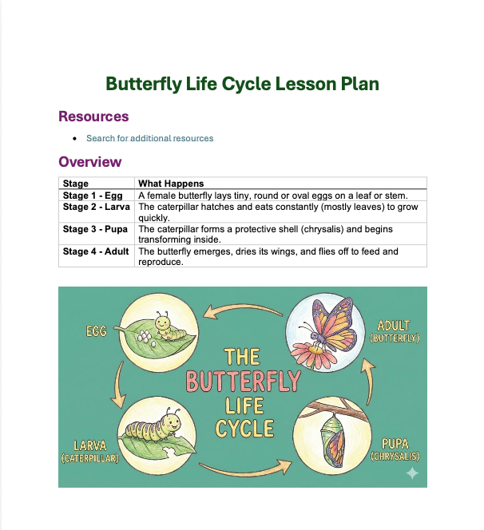
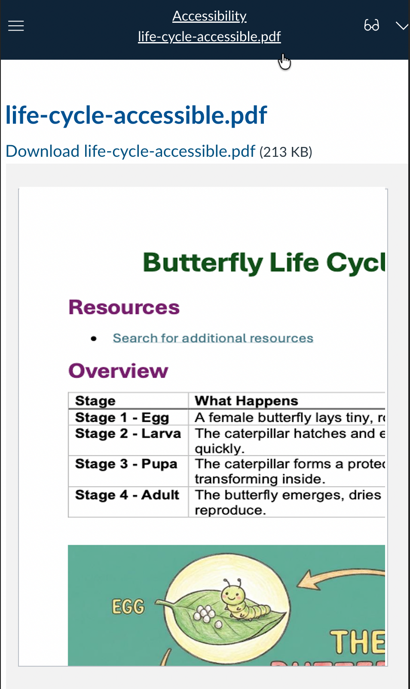
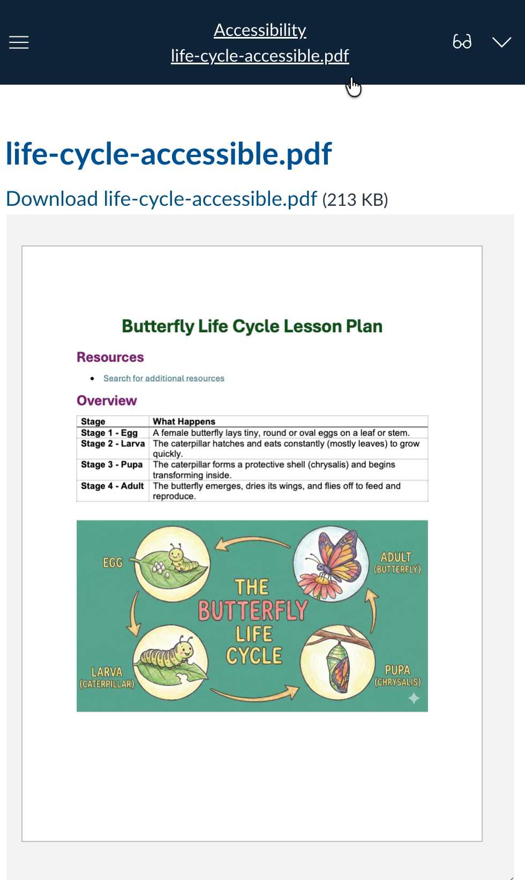
PDF Mobile Experience

Slide 28
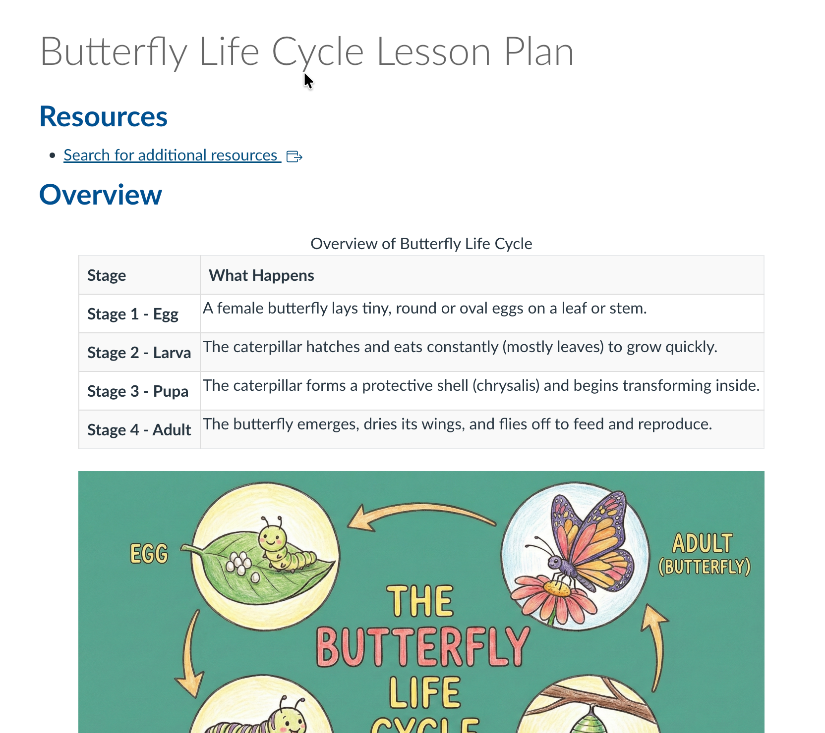
Convert to HTML

Slide 29
HTML Content
AT Supported:
text-to-speech, screen readers, contrast modes

Slide 30
Color Contrast That Works
Which color combination do you prefer? (light gray on white)​
Which color combination do you prefer? (yellow on black)​
Which color combination do you prefer? (red on white)​
Which color combination do you prefer? (light blue on dark blue)​
Which color combination do you prefer? (black on white)​

Slide 31

Use High Color Contrast​
Contrast must be sufficient:​​
  4.5:1 ratio of text color to background color, or ​​
  3:1 ratio of text color to background color for text that’s 14pt and bold or 18pt.​​
Remember contrast in hyperlinks, charts, graphs, forms, and images!​​
WebAIM Color Contrast Checker
AT Supported: magnification/zoom, device contrast modes, eye gaze, switch use

Slide 32
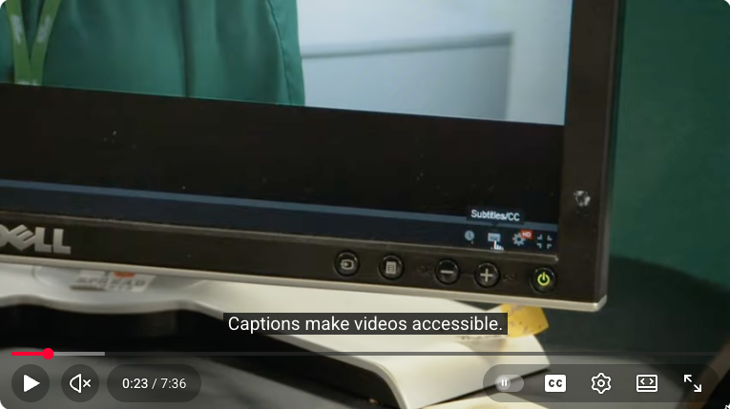
Video Captions

Slide 33
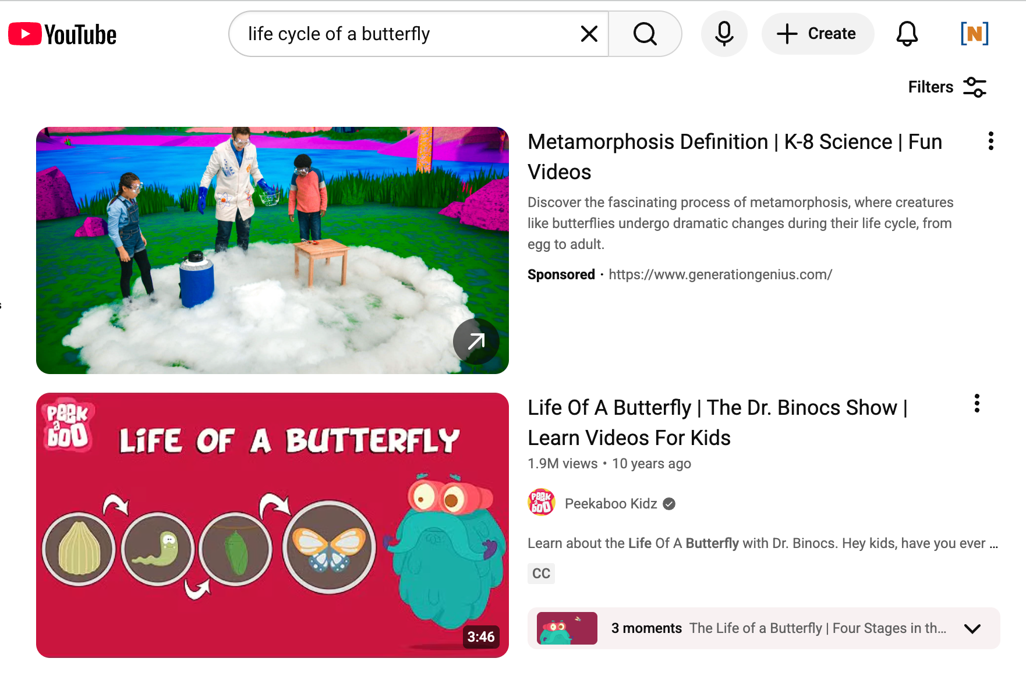
Captioned Videos

Slide 34
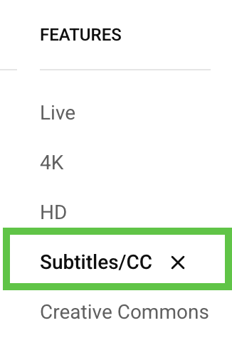
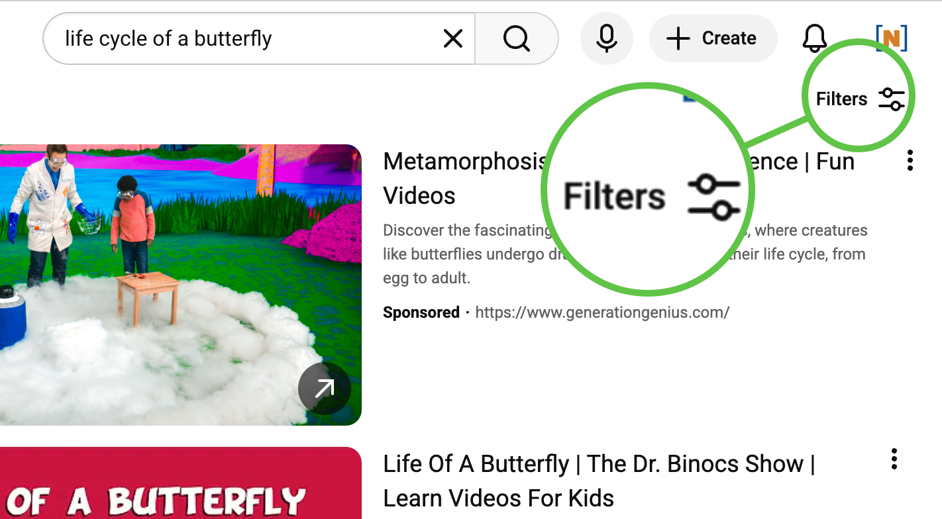
Subtitles/CSS Filter

Slide 35
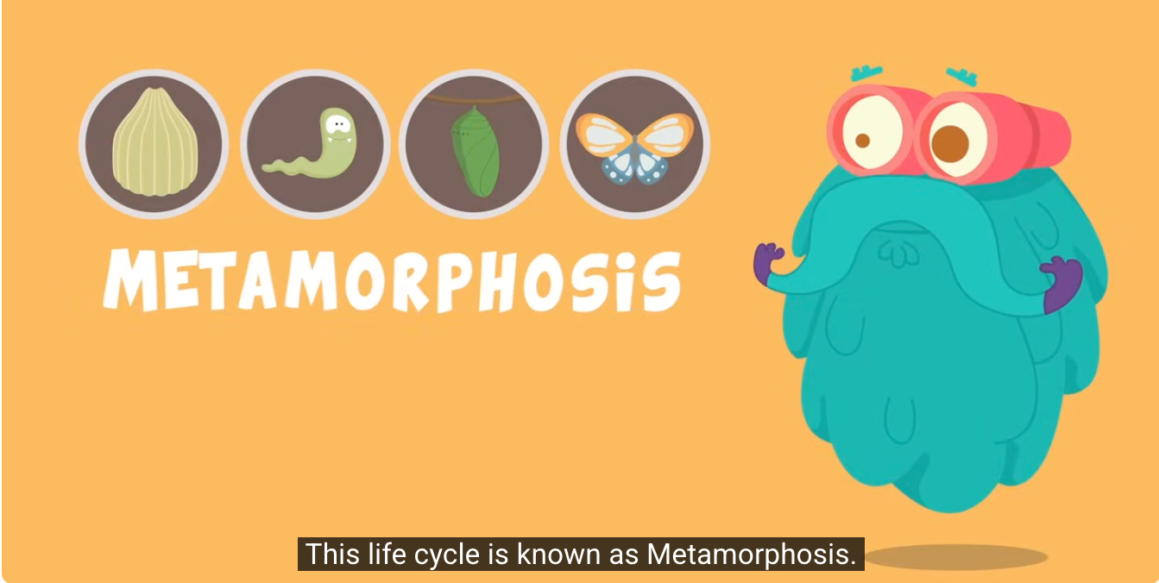
Captions
AT Supported:
screen readers, magnification/zoom, contrast modes

Slide 36
Recognizable, Meaningful Links
Click here to learn more.
Learn more at: https://example.com.
  But what if?
Explore Native American history resources.

Slide 37
What Does It Take?
Ensuring links are visually distinguishable (color & underline)
Avoiding copied URLs & vague link text
AT Supported:
voice control, magnification/zoom, text-to-speech, screen readers,
braille displays

Slide 38
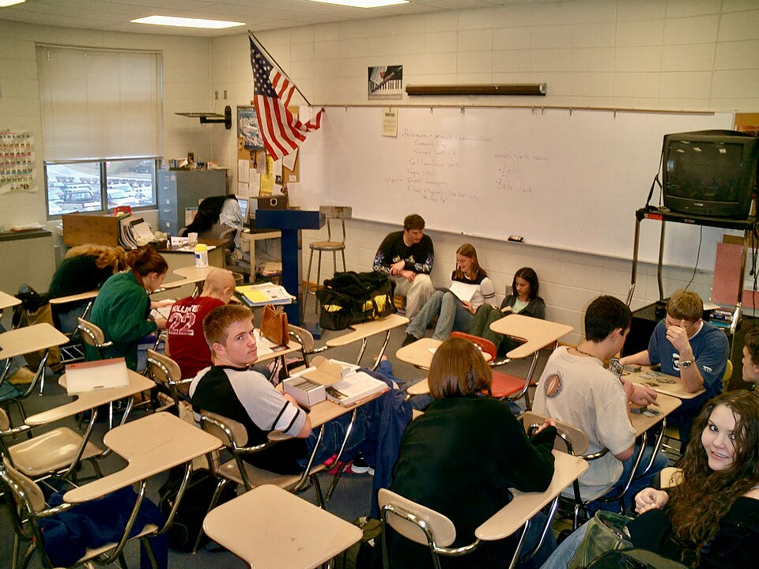
Consistent Navigation
Notes:
Image source: https://commons.wikimedia.org/wiki/File:Students_in_a_high_school_classroom_in_North_Carolina_03.jpg

Slide 39
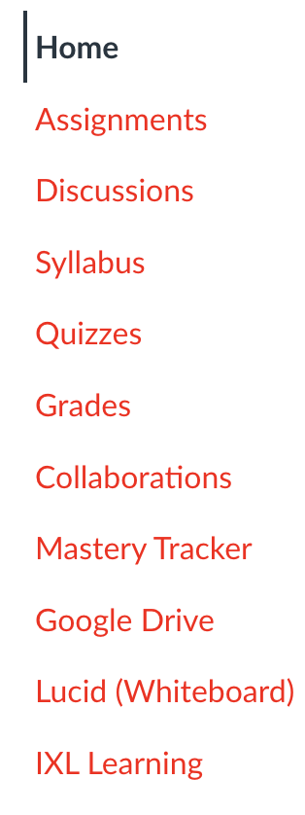
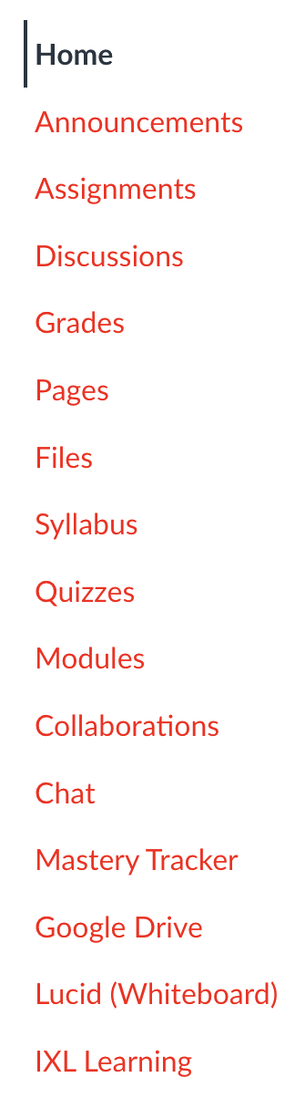
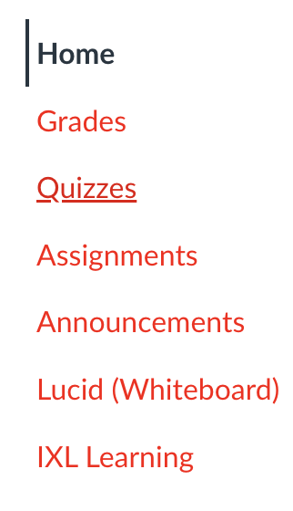
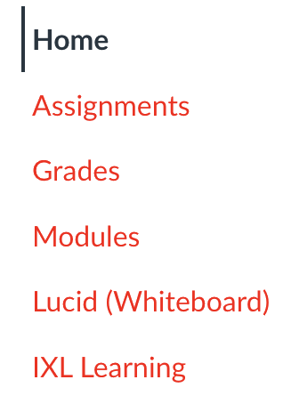
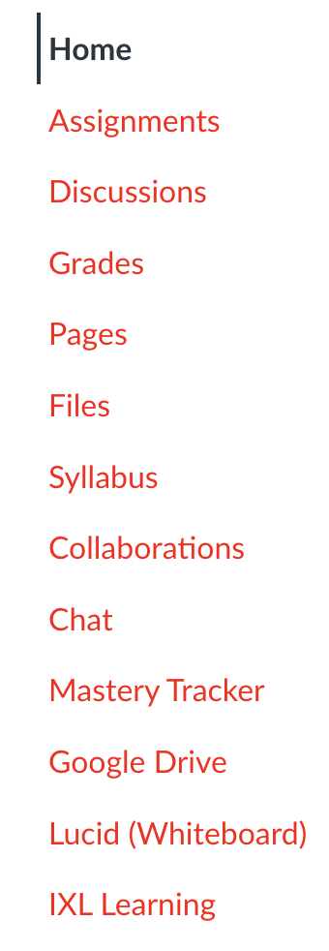
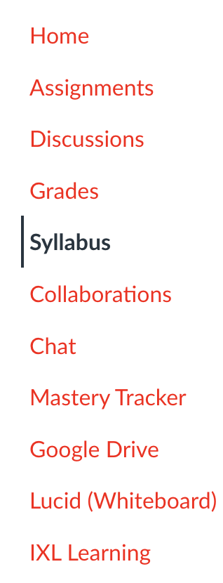
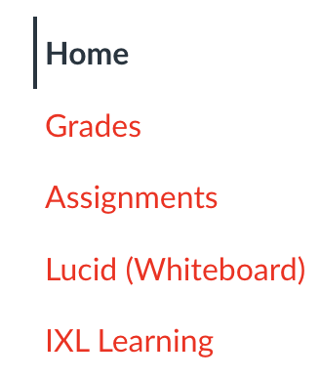
Online Course Navigation

Slide 40
Questions

Slide 41
Get People Talking
Your Challenge:
Connect with one colleague at your school, district, or state to explore an accessibility practice in your setting.​
  Try these conversation starters!
Conversation Starters:
“How do we currently ensure that all students with disabilities have access to digital learning materials?”
“Who’s responsible for digital accessibility in our department or across our system?”
“Have we ever assessed whether our current digital tools or materials are accessible to learners with disabilities?”
“What policies or practices do we already have in place that relate to digital accessibility?”
“Where do you think we have opportunities to improve access for students with disabilities?”

Slide 42
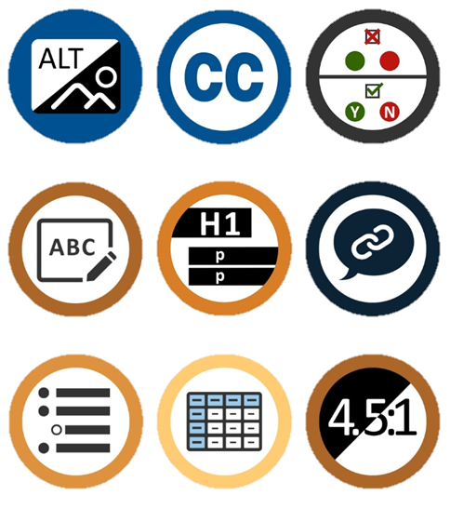
Accessibility Resources from NCADEMI
Accessibility Basics
Learning Modules
Digital Accessibility Roadmap
Accessible Digital Educational Materials Quality Indicators

Slide 43

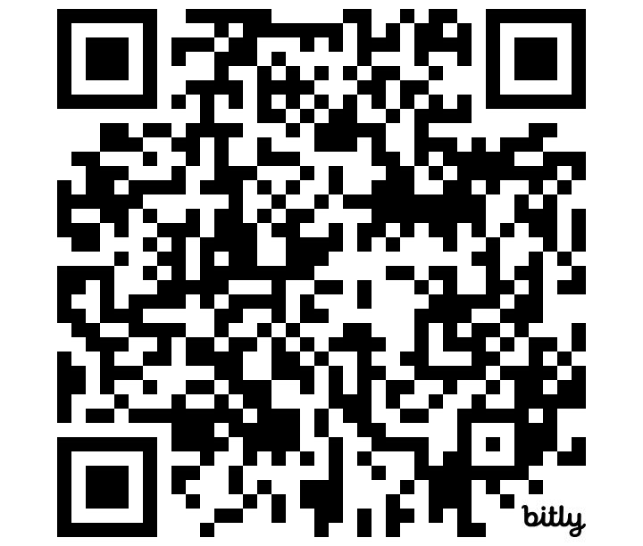



Contact, Connect, and Stay Informed
Contact & Connect
Stay Informed
ncademi.org/newsletter
  ncademi.org
  ncademi@usu.edu
  435.554.8213 (voice or text)
  Follow us on LinkedIn

Slide 44


Disclaimer
The contents of this slide deck were developed under a cooperative agreement with the U.S. Department of Education, Office of Special Education Programs, Award No. H327Z240007. However, those contents do not necessarily represent the policy of the Department of Education, and you should not assume endorsement by the Federal Government. Project Officer: Rebecca Sheffield, Ph.D.​
The contents of this slide deck are licensed under a Creative Commons Attribution-ShareAlike 4.0 International License (CC BY-SA 4.0).​

Slide 45
ACVREP CEU Session End Code
If you do not plan to claim ACVREP CEUs (primarily for Vision Impairment Specialists), you do not need to note these codes.
  End Code:
This session has been approved for ACVREP CEUs. If you plan to claim ACVREP CEUs, please note this code, and the start code that was be shown at the beginning of this session.
Please visit atia.org/ceus-in-person for full information on how to claim CEUs.

Slide 46
Session Evaluation and CEUs
Session Feedback Evaluation
Your feedback is very important to us and the presenters get to see it! Please be sure to complete session evaluations through the ATIA mobile app.
CEUs
Presentations are reviewed for ASHA, ACVREP, AOTA, CRC and IACET CEU eligibility. Not all sessions are approved for each specialty CEU.
You must complete a CEU assessment for each session and CEU type you’d like to claim prior to the deadline.
  In-person deadline to claim CEUs: Friday, February 27, 2026
  Virtual Event deadline to claim CEUs: Saturday, April 30, 2026
Please visit: atia.org/ceus-in-person

Slide 47
Thank You

